Slide 2
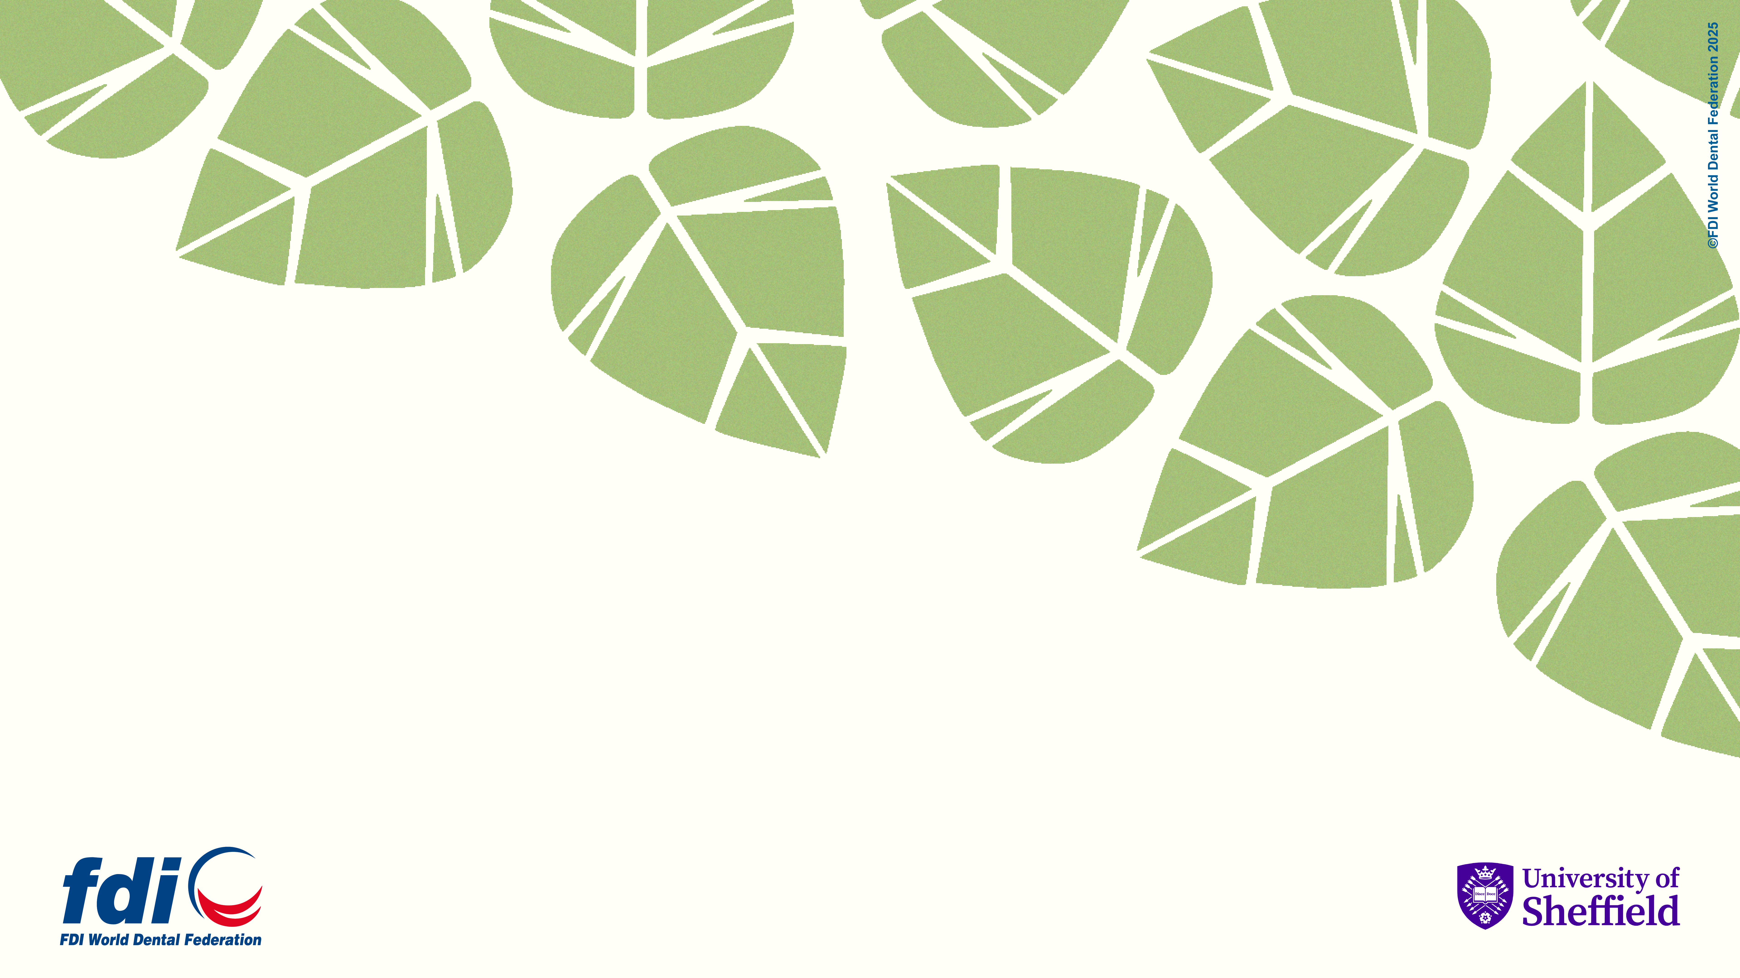
Policy and Regulations

Slide 3
Environmental Sustainability
Active engagement with environmental policies and regulations in oral healthcare will mitigate your environmental impact.
Engage with effective Antibiotic Stewardship.
Follow current regulations to handle, manage, and dispose of dental amalgam safely.
Adopt evidence-based clinical care guidelines to determine patient care pathways and follow-up appointments (e.g., Delivering Better Oral Health, NICE guidelines on recall intervals, European Federation of Periodontology guidelines).

Slide 4
Procurement

Slide 5
Environmental Sustainability
Selecting fit-for-purpose dental materials, clinical items (PPE and products) and equipment will mitigate the environmental impacts of the care you provide.
Adopt a prevention-first approach to reduce oral healthcare interventions, material use, and
associated environmental impact.
Proactively reduce the use of amalgam in line with the Minamata Convention to phase down and phase out the use of amalgam in clinical dental practice.
Use high-quality materials and follow clinical guides to optimize restoration longevity.
Critically evaluate the environmental impact of all dental materials and incorporate this into decision-making at all levels.
Follow the Directions for Use (DFUs) carefully for each material system for correct and optimum clinical outcomes.
Limit the use of dental amalgam to reduce waste produced.

Slide 6
Waste Management

Slide 7
Environmental Sustainability
Reducing and recycling plastic waste will mitigate the environmental impacts of the care you provide.
Minimize single use plastics as much as possible and replace with reusable items including matrix band retainers, anaesthetic syringes, aspiration tips, Dappen’s pots.
Adopt reusables where possible to reduce single use plastic waste.

Slide 8
Dental Material Use

Slide 9
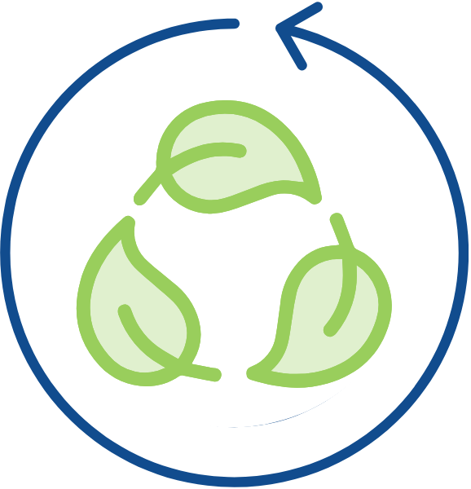
Environmental Sustainability
Reducing gypsum use for dental casts will mitigate the environmental impacts of the care you provide.
Employ intra-oral scanning to reduce impression material and gypsum waste.
Consider 3D printing and biodegradable resins to produce models.
Adopt biodegradable alternatives to gypsum.
Consider recycling options for gypsum.

Slide 10
Environmental Sustainability
Managing amalgam waste through safe practices will mitigate the environmental impacts of the care you provide.
Use water-spray and high-volume aspiration when removing amalgam restorations.
Have an amalgam spill-kit for managing elemental mercury.
Avoid the use of hypochlorite cleaners, as they increase dissolution of mercury.
Use effective chairside traps, vacuum filters, and amalgam separators that meet ISO 11143.
Recycle waste amalgam with effective collection, separation, and recovery of mercury and silver through approved biological waste management companies.

Slide 11
Sustainability in Dentistry MOOCs
MOOC 2
Practical Applications of Sustainability in Dentistry
Understand how to implement sustainable practices using the FDI Sustainability Toolkit and other resources and guidance.
MOOC 1
Sustainability in Dentistry
Discover the impact of oral healthcare on the environment and the basic concepts of sustainable practice.

Slide 12
Acknowledgements
Slides
Thank you to Dr. Jonathan Dixon (Clinical Academic Fellow in Restorative Dentistry) for supporting the development of these slides and associated resources, under the supervision of Prof. Nicolas Martin (Clinical Professor in Restorative Dentistry).
Research
Thank you to the authors of the research paper identifying a comprehensive strategy for the inclusion and delivery of Environmental Sustainability in the curriculum.
Dixon, J., Field, J., Gibson, E., and Martin, N. (2024). Curriculum content for Environmental Sustainability in Dentistry. Journal of Dentistry, 147, 105021. doi: https://doi.org/10.1016/j.jdent.2024.105021
Martin, N. and Mulligan, S. (2022). Environmental Sustainability Through Good-Quality Oral Healthcare. International Dental Journal. doi: https://doi.org/10.1016/j.identj.2021.06.005
Task Team
Thank you to the Sustainability in Dentistry Task Team for providing guidance and scientific expertise to ensure sound implementation of the entire Sustainability in Dentistry Project. The team includes:
Chair: Prof. Nicolas Martin (United Kingdom)
Members:
Dr. Steven Mulligan (United Kingdom)
Asst. Prof. Duygu Ilhan (Türkiye)
Asst. Prof. Hasan Jamal (Saudi Arabia)
Asst. Prof. Donna Hackley (United States of America)
Dr. Mick Armstrong (United Kingdom)

Slide 13
Partners and Supporters
The Sustainability in Dentistry project is supported by our Partners and Sponsors:
Partners
Supporters

