Slide 1


Slide 2

Behaviour Change

Slide 3




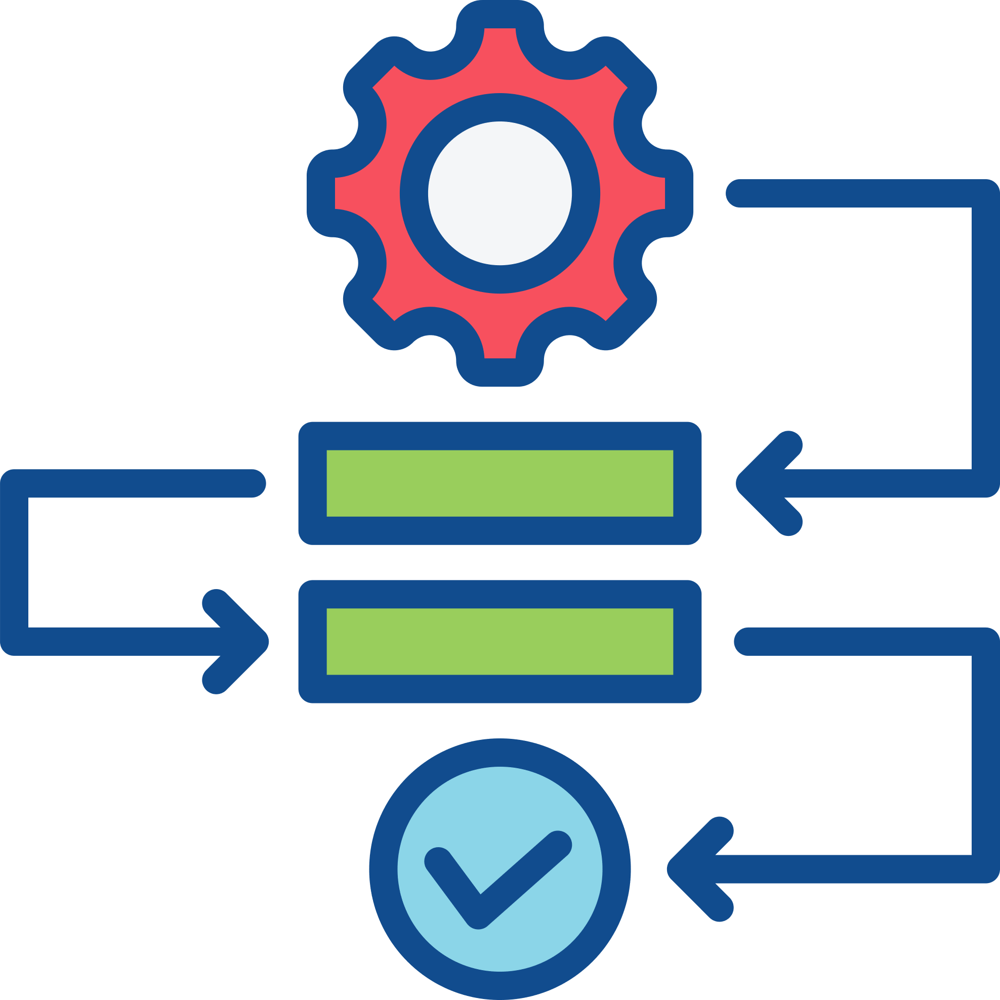



Environmental Sustainability
Environmental sustainability requires a culture change across the profession and supply chain.
Normalizing the subject of Environmental Sustainability.
Start with informal discussions to increase awareness and increasingly formalize into organizational/practice protocols and procedures (e.g., designate sustainability leads).
Translating personal, home-based attitudes and behaviours to the professional setting.
Apprehension and resistance to ES behaviour changes can be overcome by increasing awareness and identifying common ground and strength of feelings amongst colleagues.

Slide 4





Environmental Sustainability
The formulation of action plans and policies will result in more environmentally sustainable practice.
Designate a lead sustainability officer, dental practice champion, or create a sustainability working group.
Add sustainability to the practice agenda and ethos.
Foster an inclusive environment where staff can exchange ideas on ways to do things better.

Slide 5
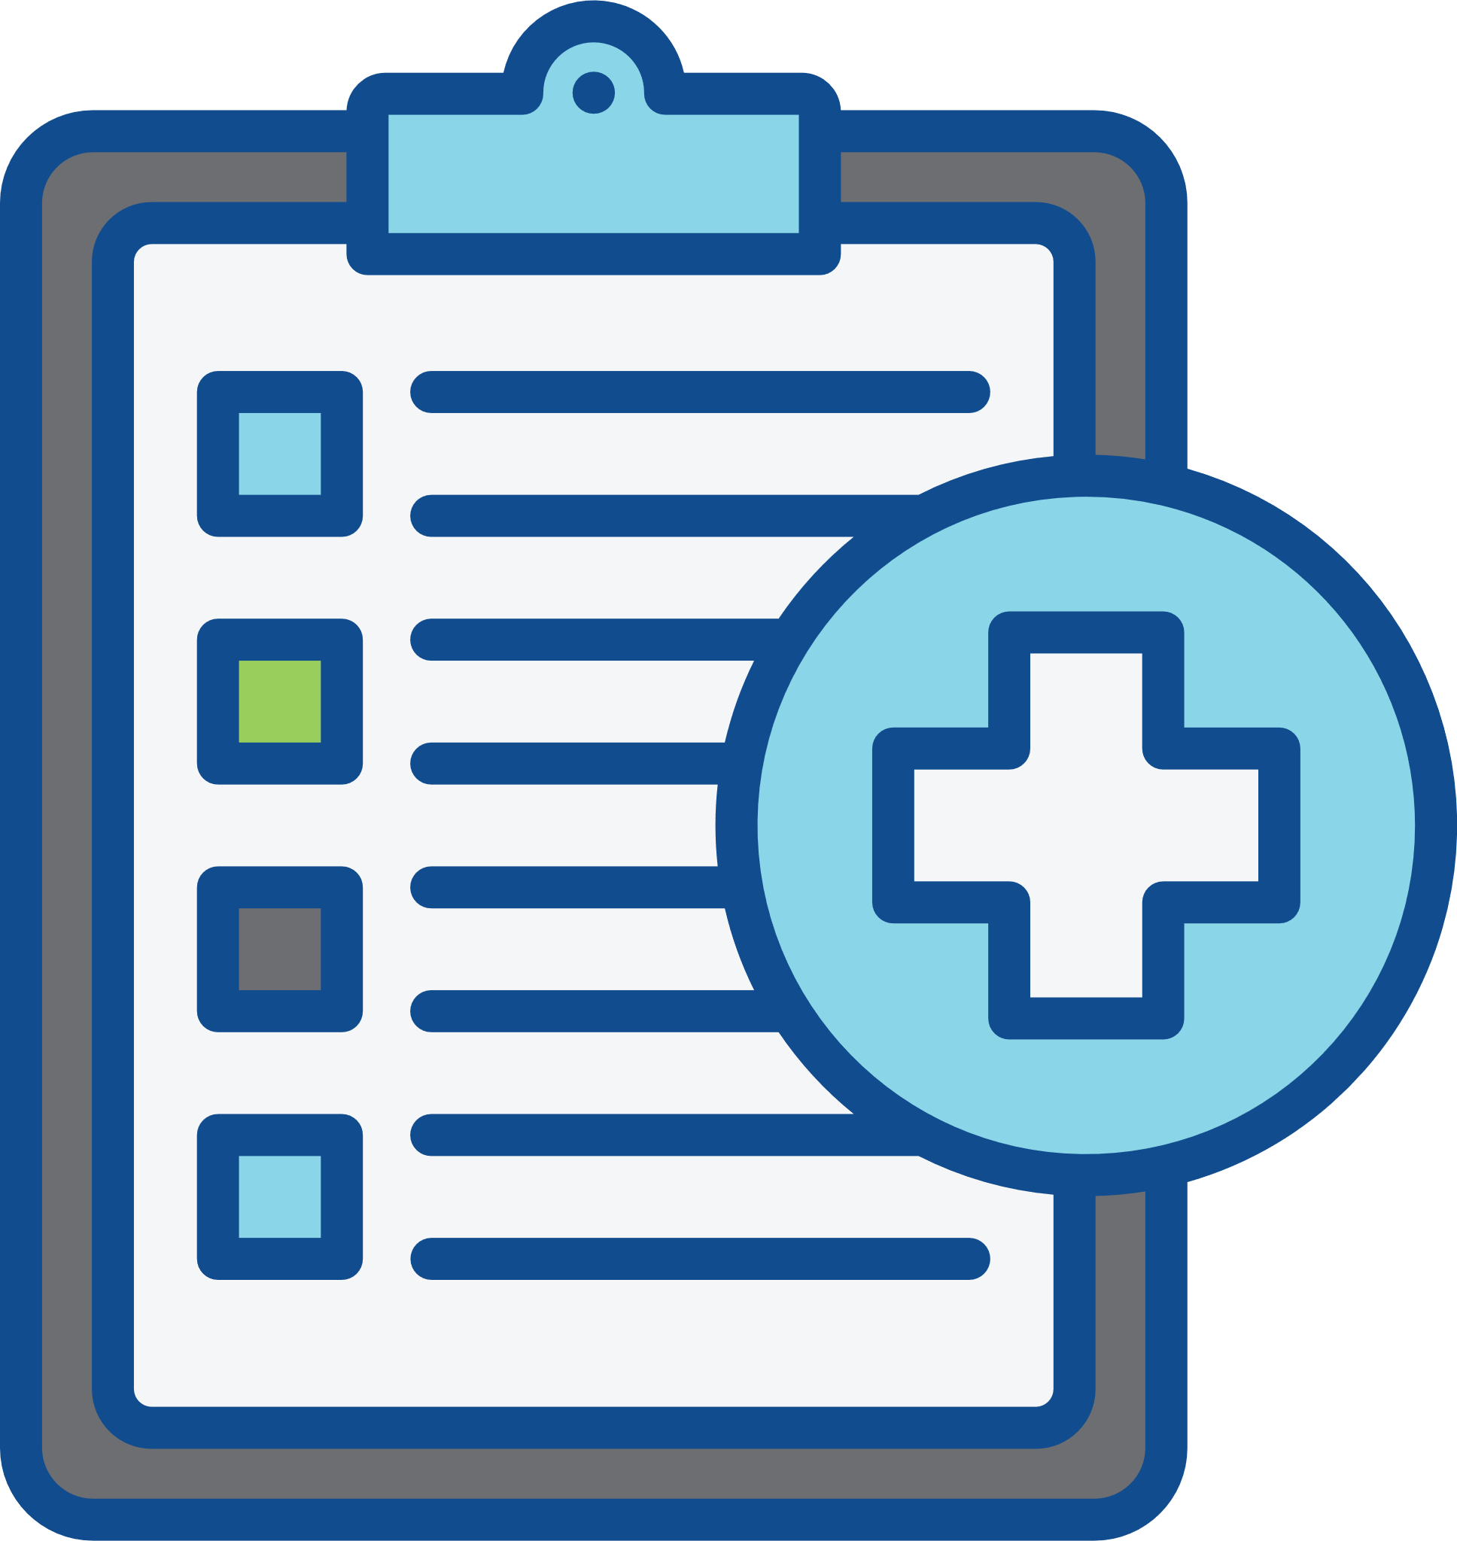

Environmental Sustainability
Avoid waste: high-quality and efficient patient care will mitigate environmental impacts.
Only use what is necessary by planning each patient encounter.
Focus on high-quality care by using fit-for-purpose materials and instruments that are grounded in evidence-based techniques.

Slide 6
The 4 Rs
(Reduce, Reuse, Recycle, Rethink)

Slide 7




Environmental Sustainability
Use reusable options where appropriate.
Use of cloth fabric alternatives to SUPs, including clothes, barriers, and cleaning items.
Reusable PPE: laboratory coats to replace aprons, reusable face shields, and patient bibs.
Use of washable cups, dishes, and cutlery.
Reusable instruments (impression trays, suction tips, matrix band retainers).

Slide 8
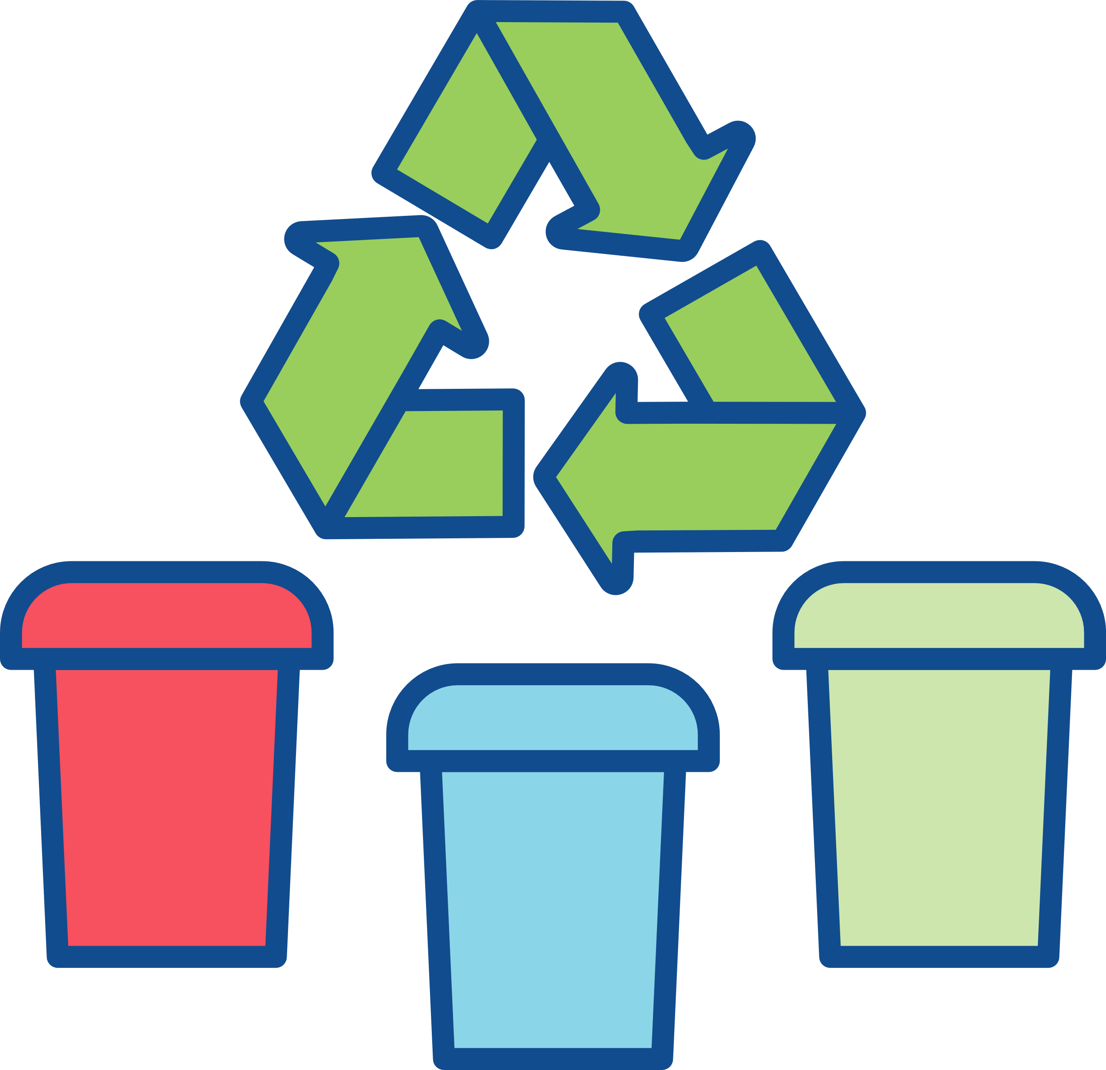





Environmental Sustainability
A shift from a wasteful linear economy to a more sustainable circular economy in oral
healthcare is possible by proactively seeking and implementing recycling opportunities.
Segregate your waste and recycle.
Ensure your items are recyclable, quality over quantity.
Improve awareness and liaise with local authorities and support groups.
Identify and use pre-existing community recycling programmes to recycle separated paper and plastic parts of autoclavable bags and packaging.
Recycle office waste such as plastics, paper and medical shredding, and printer cartridges.

Slide 9




Environmental Sustainability
Rethink – how can you optimize existing systems and processes to be more environmentally sustainable?
Use of digital technology for patient appointments, records, and electronic reminders.
Electronic credit card transfers and order forms.
Reduce paper use.
Engage with emerging scientific/technological changes to the profession.

Slide 10
Good Quality
Oral Healthcare

Slide 11







Environmental Sustainability
There is a need to take ownership of the care that you provide through lifelong learning to deliver high-quality clinical outcomes.
Effective clinical governance: review, reflect, and improve the quality of care you provide.
Engage with local networks, national organizations, and practice-based research.
Lead by example: set high standards, engage with the profession, make a difference, inspire others.
A professional that maintains knowledge and skills to a high standard is well placed to provide good quality care. Good quality care is environmentally sustainable care.
Learn and develop best practice: pursue a tailored programme of continued professional development (CPD).

Slide 12
Policy and Regulations

Slide 13

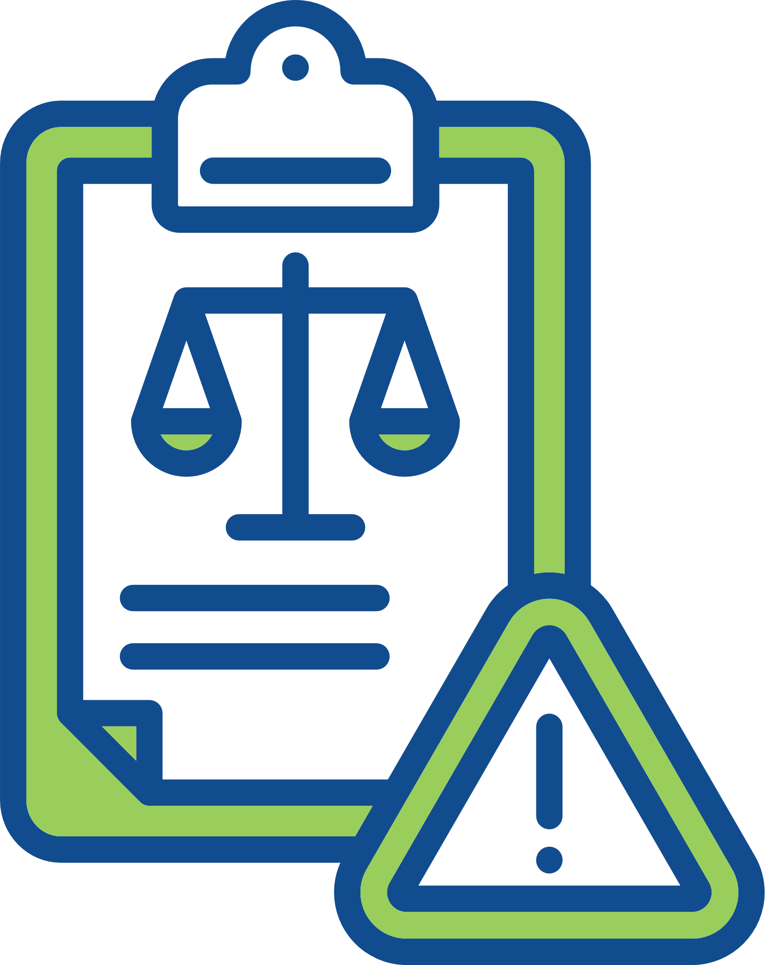


Environmental Sustainability
Active engagement with environmental policies and regulations in oral healthcare will mitigate your environmental impact.
Engage with effective Antibiotic Stewardship.
Follow current regulations to handle, manage, and dispose of dental amalgam safely.
Adopt evidence-based clinical care guidelines to determine patient care pathways and follow-up appointments (e.g., Delivering Better Oral Health, NICE guidelines on recall intervals, European Federation of Periodontology guidelines).

Slide 14

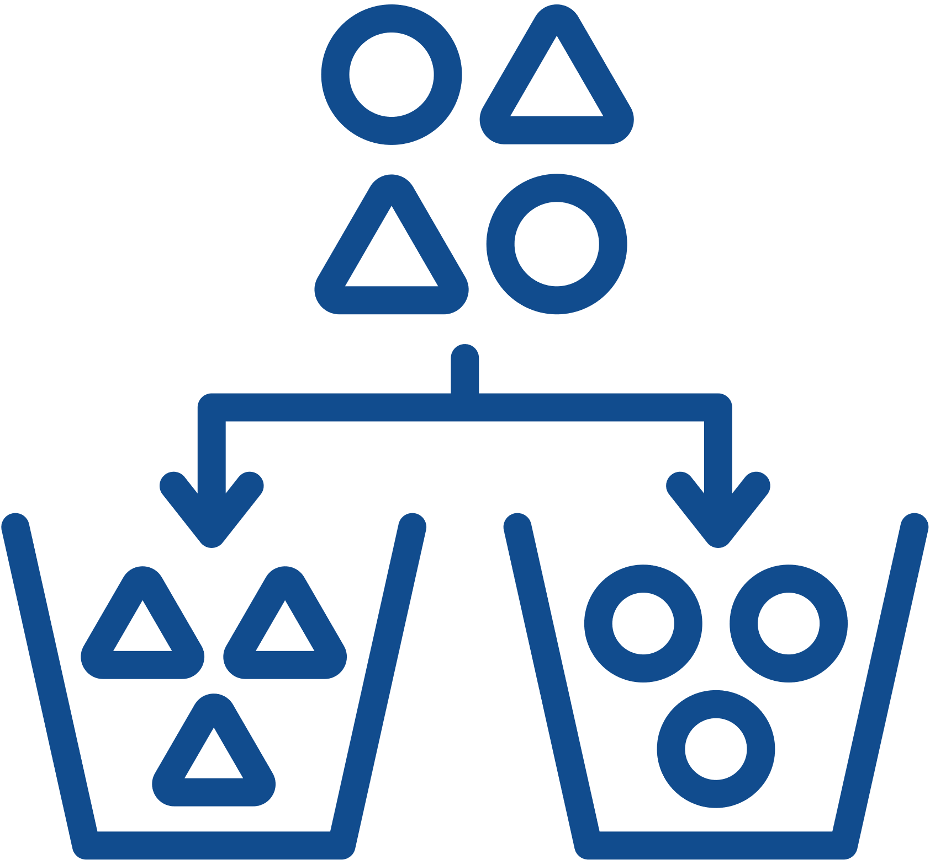
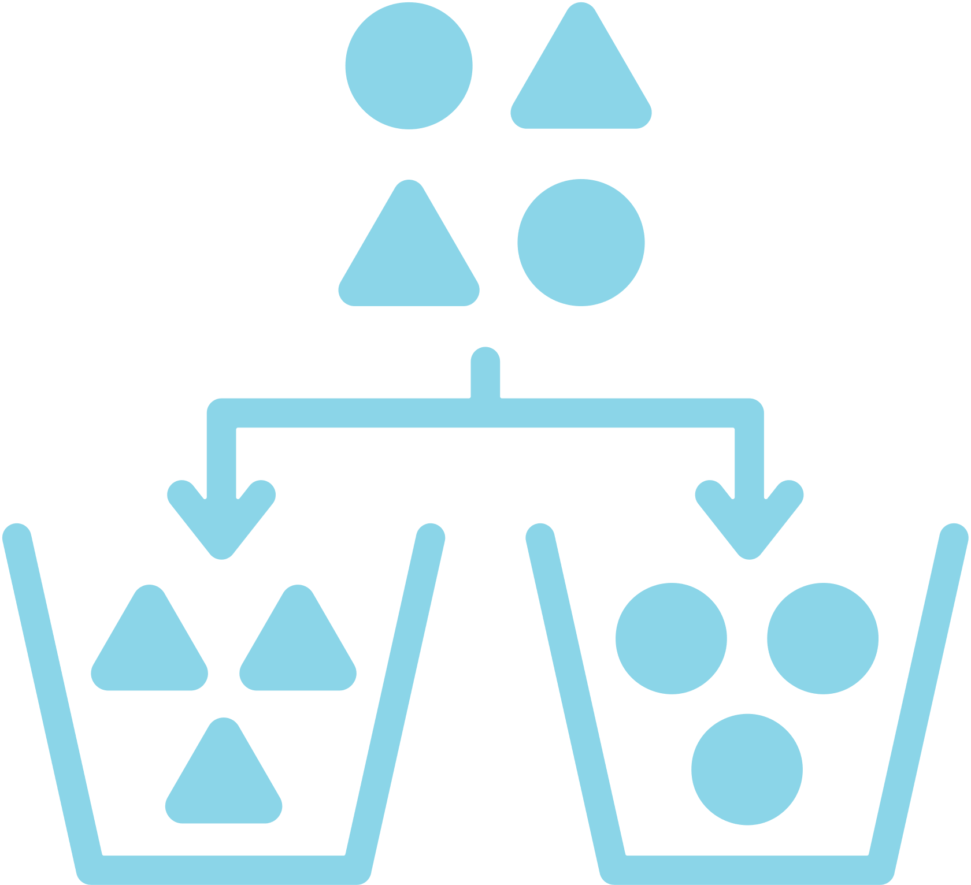
Environmental Sustainability
Active engagement and collaboration with policymakers will lead to the development of more environmentally sustainable oral healthcare policies.
Promote innovative ways to maintain high-quality care delivery whilst mitigating environmental impacts.
Engage with municipal waste management and collection services to further mitigate impacts (e.g., waste separation, recycling, energy recovery incineration).
Challenge the status quo at a local level within the workplace (e.g., laboratories, reception, common room, waste segregation).

Slide 15
Travel

Slide 16
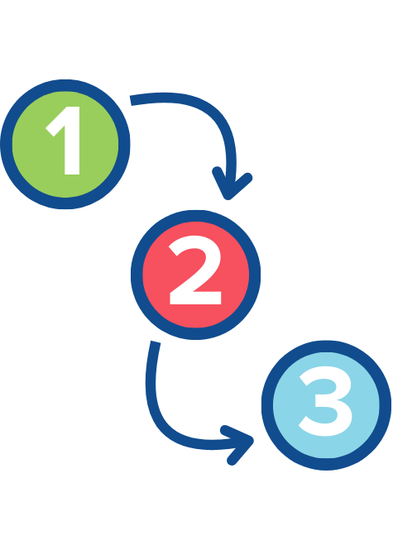



Environmental Sustainability
Planning patient care to reduce the number of appointments will mitigate the environmental impact of the care you provide.
Reduce the number of appointments by providing multiple procedures in one visit.
Engage with Tele-dentistry and Remote Clinical Consultations to reduce travel.
Combine family appointments wherever possible.
Using digital technologies (CAD-CAM, intra-oral scanning, 3D printing) will reduce the number of appointments and transport to dental laboratories.

Slide 17




Environmental Sustainability
Facilitating care delivery in multi-professional health centres will mitigate the environmental impact of the care you provide.
Engage with oral health outreach programmes where only the OHP team travels. An example is Childsmile with reduced travel, carbon emissions, and improved air quality.
Provision of on-site preventive care facilities in nursing and care homes.
Centralized resources, procurement, waste management, and circularity.

Slide 18




Environmental Sustainability
Optimizing dental practice administration will mitigate the environmental impact of the care you provide.
Optimize efficiency of transport between the clinic and the dental laboratory.
Increased use of telecommunication for all administrative logistics (e.g., SMS reminders, virtual post-op follow ups).
Centralized resources, procurement, waste management, and circularity.

Slide 19
Procurement

Slide 20


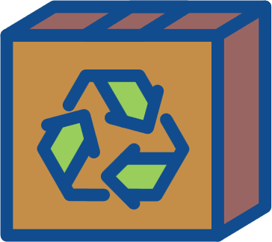
Environmental Sustainability
Engaging and challenging stakeholders across the supply chain will support environmentally sustainable practices.
Work and engage with suppliers to assess their sustainability practices.
Apply pressure to suppliers to act in an environmentally sustainable manner.
Request recycling information for medical equipment from manufacturers.
Identify locally produced items and coordinate with local suppliers to reduce travel.
Reducing and reusing packaging.

Slide 21
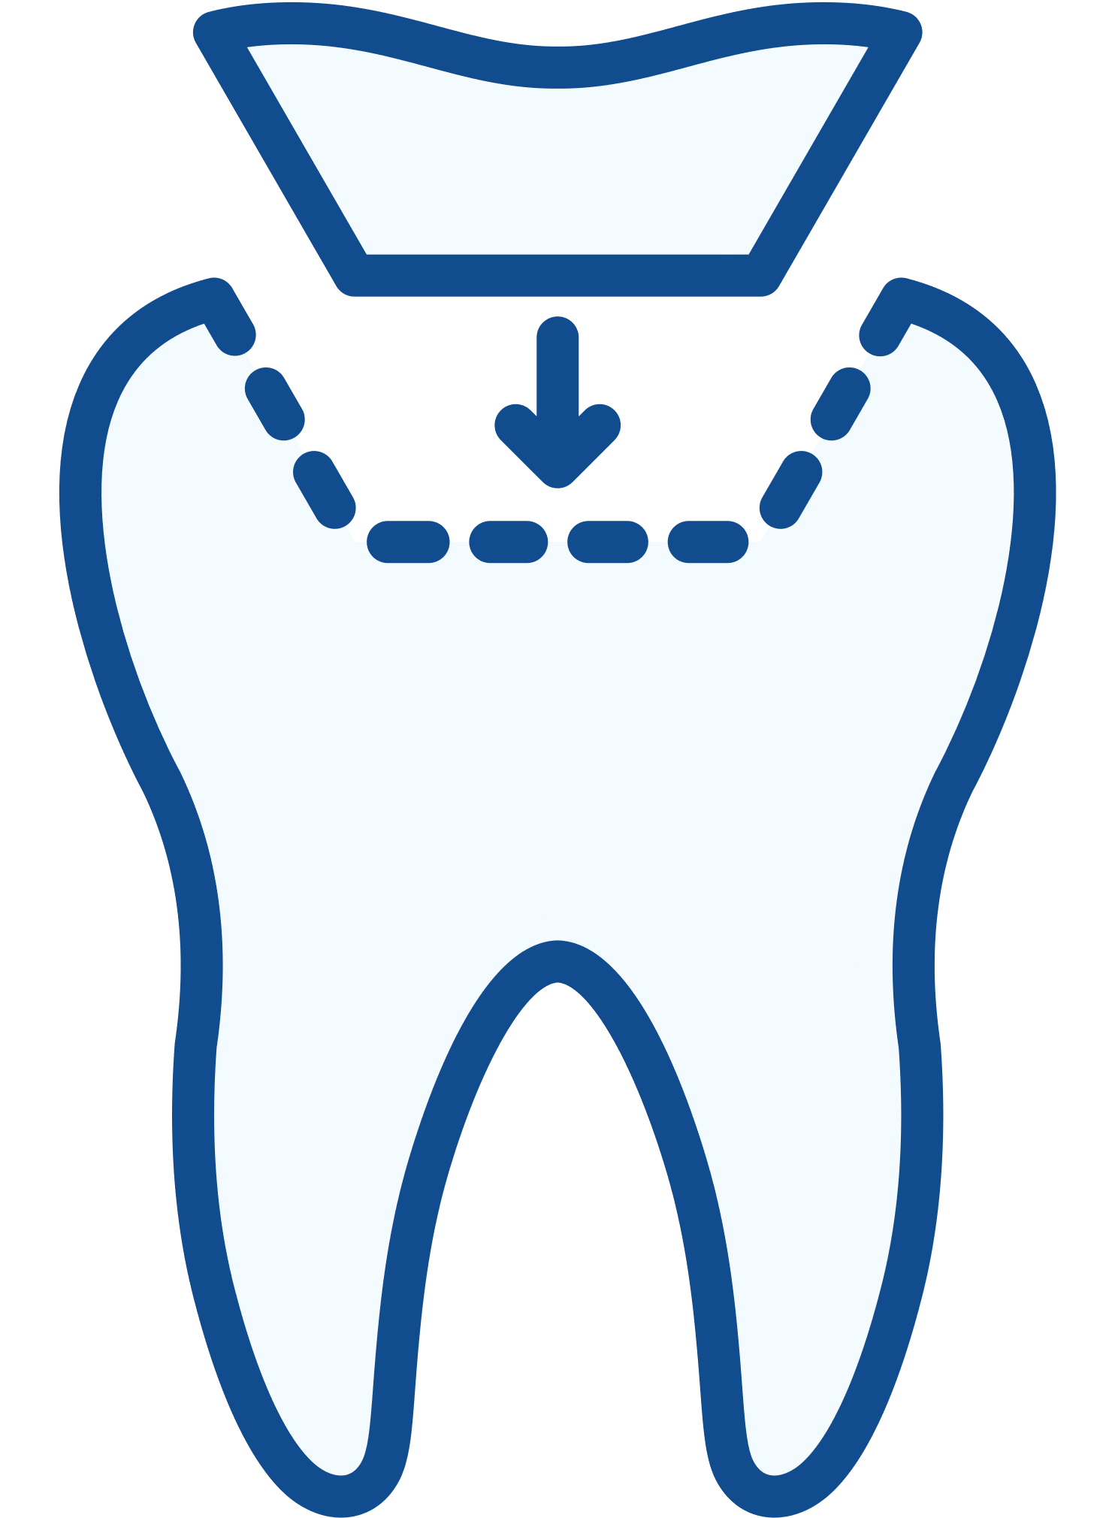




Environmental Sustainability
Selecting fit-for-purpose dental materials, clinical items (PPE and products) and equipment will mitigate the environmental impacts of the care you provide.
Adopt a prevention-first approach to reduce oral healthcare interventions, material use, and
associated environmental impact.
Proactively reduce the use of amalgam in line with the Minamata Convention to phase down and phase out the use of amalgam in clinical dental practice.
Use high-quality materials and follow clinical guides to optimize restoration longevity.
Critically evaluate the environmental impact of all dental materials and incorporate this into decision-making at all levels.
Follow the Directions for Use (DFUs) carefully for each material system for correct and optimum clinical outcomes.
Limit the use of dental amalgam to reduce waste produced.

Slide 22
Energy and
Water Consumption

Slide 23




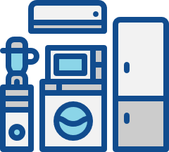


Environmental Sustainability
Reducing energy and water consumption at all levels of oral healthcare is key to mitigating the environmental impacts of oral healthcare.
Use energy-efficient appliances (e.g., LED, fluorescent bulbs, light sensors, dimmer switches).
Make use of natural lighting and turn off the lights when not in use.
Turn off the tap when brushing.
Maintain and upgrade boilers and air conditioning units to ensure they are energy efficient.
Better use of windows and blinds to regulate temperature before using air conditioning.
Use appliances when fully loaded.

Slide 24



Environmental Sustainability
The use of energy from renewable sources will mitigate your environmental impacts.
Produce your own renewable energy through the use of solar panels, wind turbines, solar thermal systems, and heat pumps.
Engage with energy companies that use renewable energy.

Slide 25
Waste Management

Slide 26



Environmental Sustainability
Developing and implementing a local environmentally sustainable waste management plan will mitigate your environmental impacts.
Implement the 4 Rs (reduce, reuse, recycle, rethink).
Identify and use effective waste disposal services that are close to the practice.
Incorporate the management of food waste, consider energy conversion or composting.
Use licensed handlers for off-site recycling of hazardous materials.
Use incineration facilities with energy recovery where possible.
Waste segregation.

Slide 27
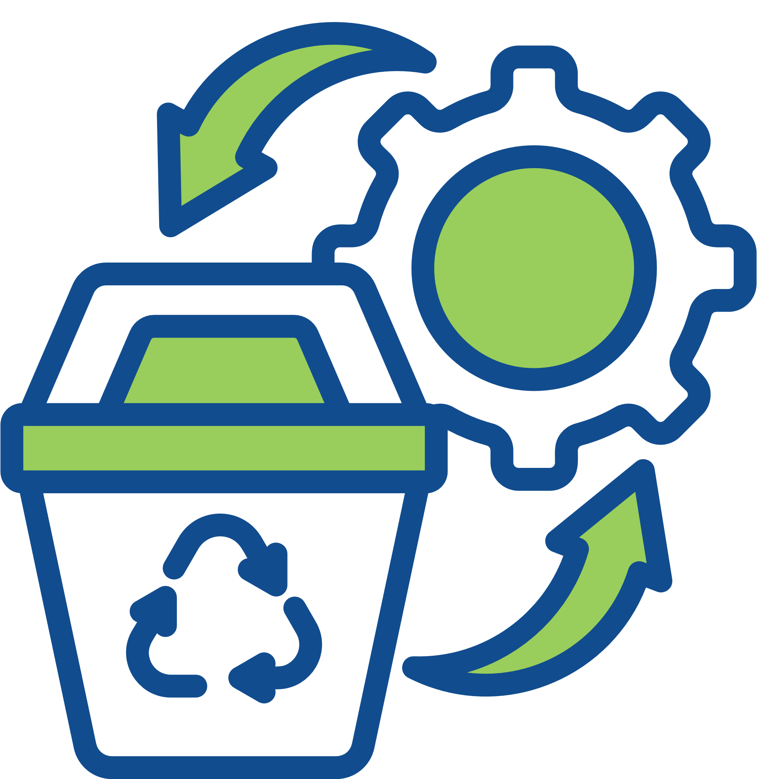



Environmental Sustainability
Engaging and challenging all stakeholders will result in more environmentally sustainable waste disposal procedures.
Increase awareness of waste management and the associated costs.
Ensure effective waste segregation.
Ensure that waste contractors are complying with the appropriate local and national legislation at all levels, from collection to disposal.
Encourage contractors to diversify to include novel recycling opportunities.

Slide 28


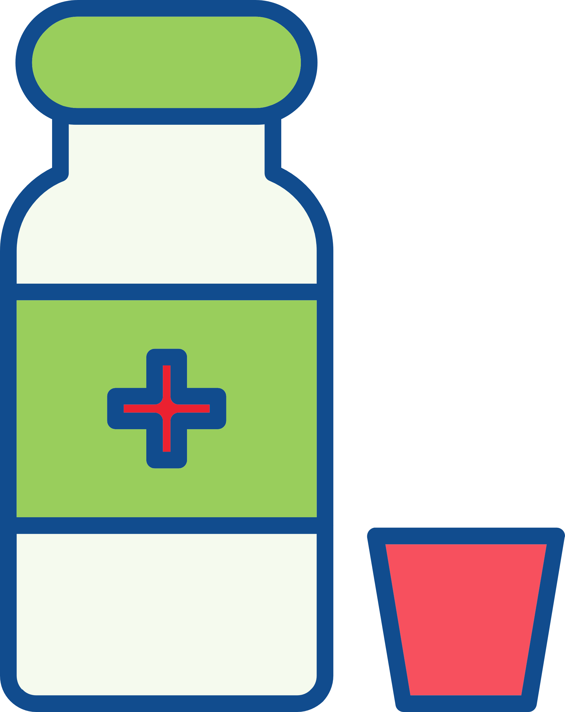
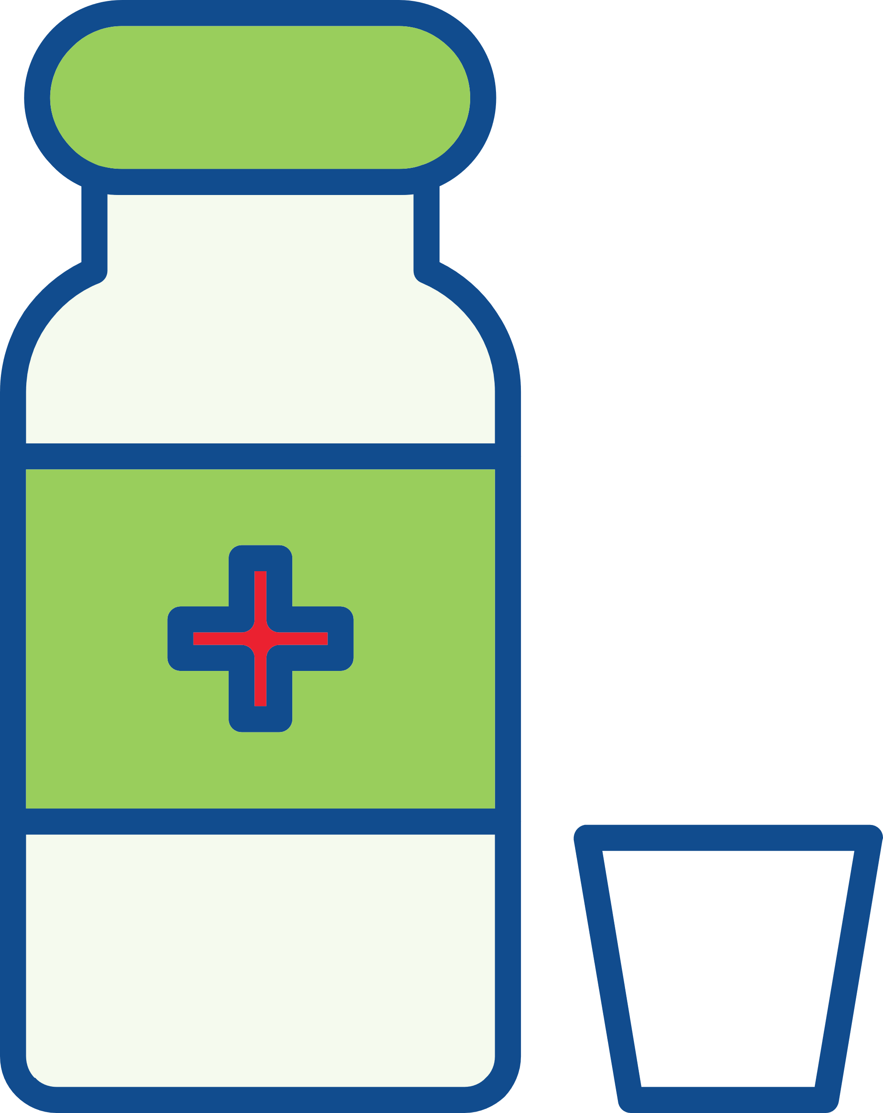
Environmental Sustainability
Reducing and recycling plastic waste will mitigate the environmental impacts of the care you provide.
Minimize single use plastics as much as possible and replace with reusable items including matrix band retainers, anaesthetic syringes, aspiration tips, Dappen’s pots.
Adopt reusables where possible to reduce single use plastic waste.

Slide 29
Dental Material Use

Slide 30




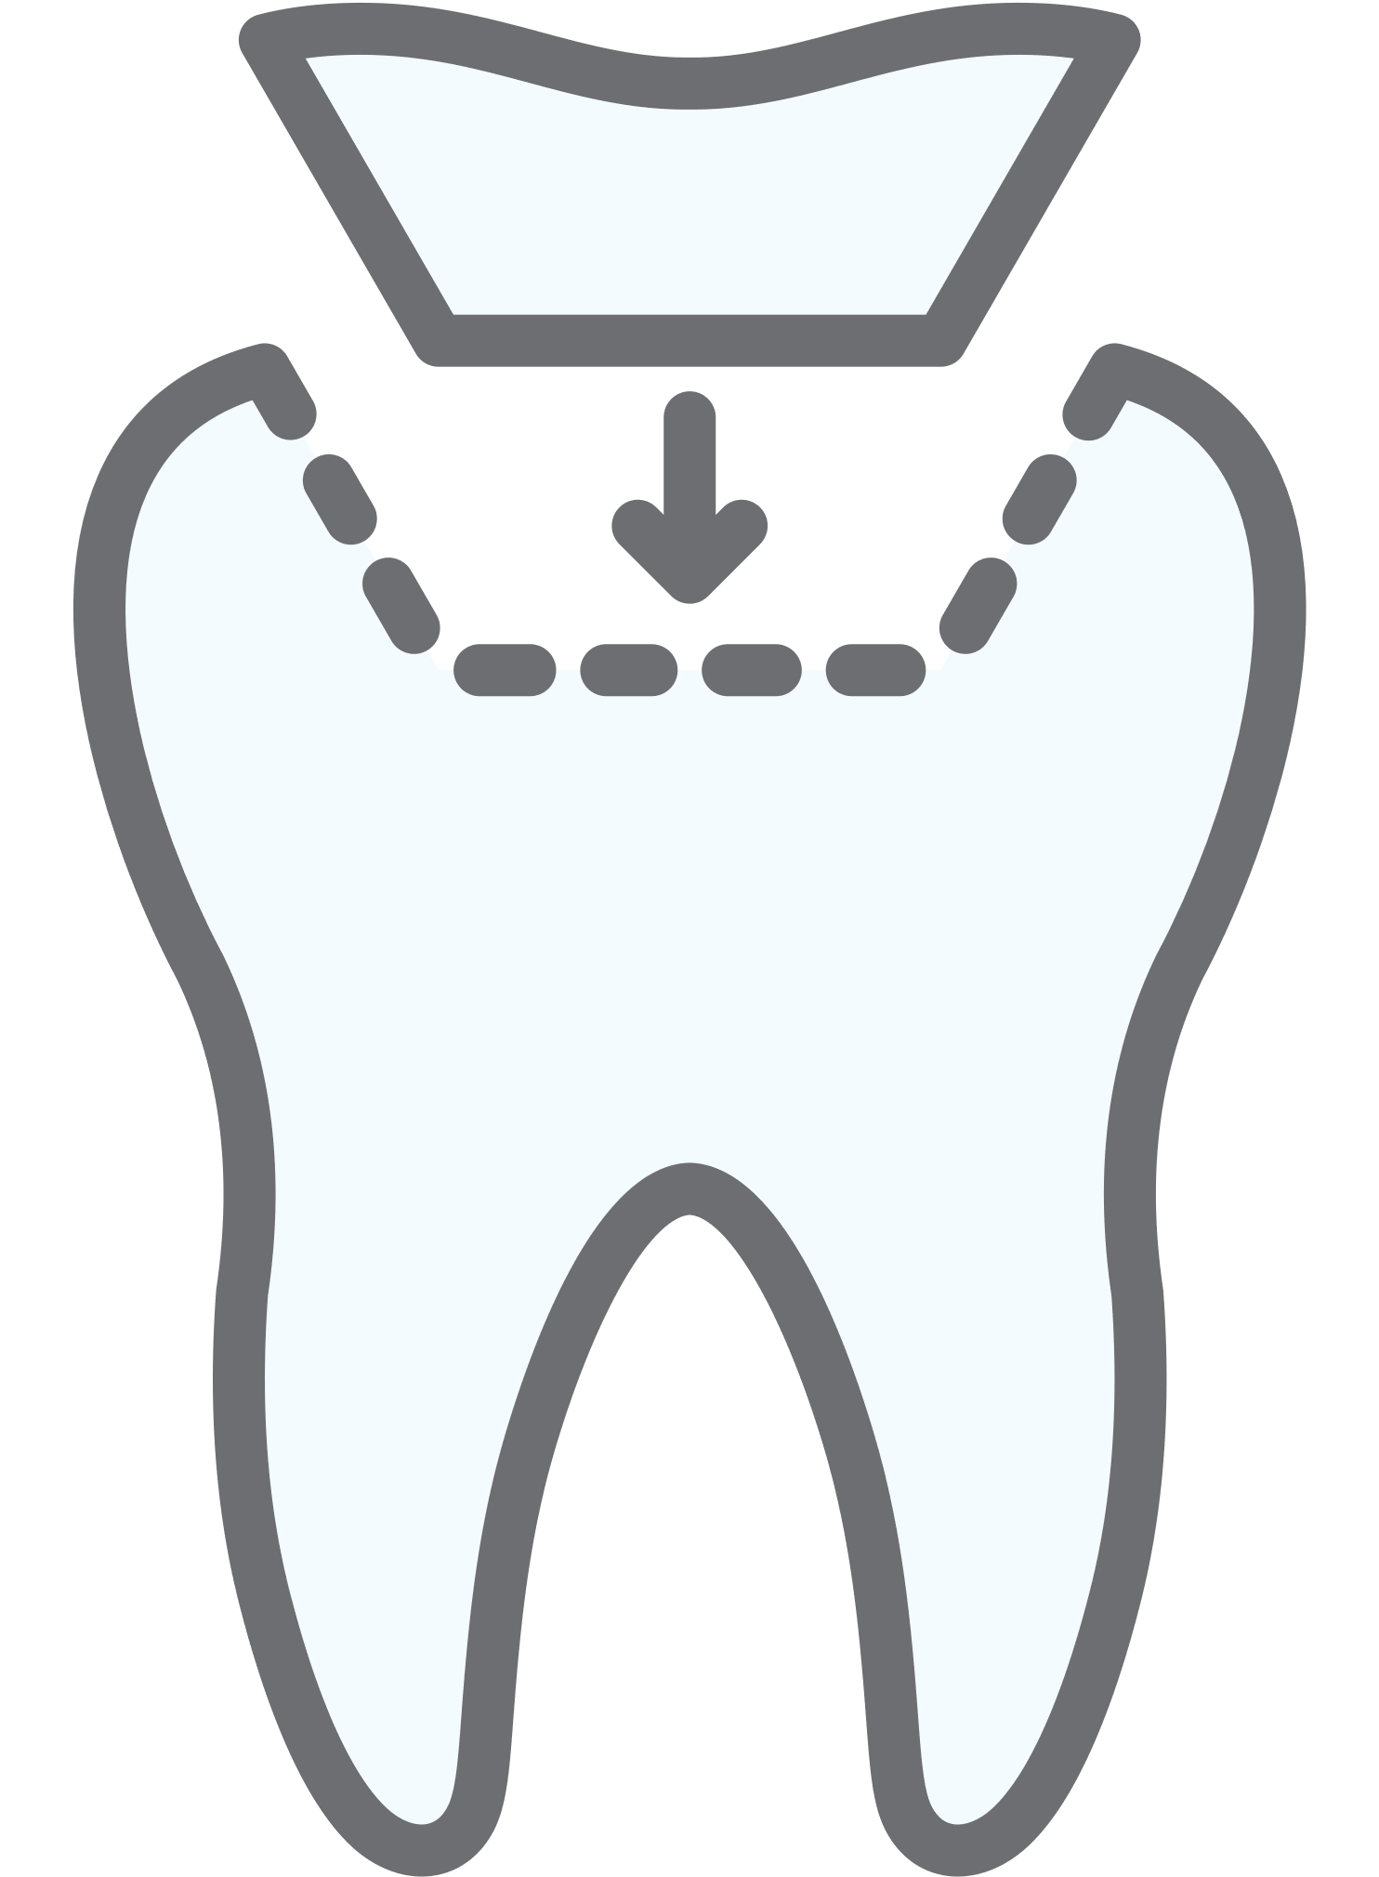

Environmental Sustainability
Managing amalgam waste through safe practices will mitigate the environmental impacts of the care you provide.
Use water-spray and high-volume aspiration when removing amalgam restorations.
Have an amalgam spill-kit for managing elemental mercury.
Avoid the use of hypochlorite cleaners, as they increase dissolution of mercury.
Use effective chairside traps, vacuum filters, and amalgam separators that meet ISO 11143.
Recycle waste amalgam with effective collection, separation, and recovery of mercury and silver through approved biological waste management companies.

Slide 31



Environmental Sustainability
Reducing gypsum use for dental casts will mitigate the environmental impacts of the care you provide.
Employ intra-oral scanning to reduce impression material and gypsum waste.
Consider 3D printing and biodegradable resins to produce models.
Adopt biodegradable alternatives to gypsum.
Consider recycling options for gypsum.

Slide 32

Environmental Sustainability
Recovering and recycling dental materials, clinical items (PPE and products) and equipment will mitigate the environmental impacts of the care you provide.
Recycle waste amalgam, gypsum, lead foil, and metal used in fixed/removable prosthodontics.
Segregate and recycle sterile packaging.
Use surgery zoning to separate contaminated and non-contaminated waste and facilitate recycling of these items where possible.

Slide 33




Environmental Sustainability
Using digital radiography will mitigate the environmental impacts of the care you provide.
Reduced use of harmful silver thiosulphate fixer.
Reduction of lead foil waste.
Improved image quality, reduced radiation exposure, editing abilities, facilitated storage & access.

Slide 34


Environmental Sustainability
Using environmentally sustainable disinfectant procedures will mitigate the environmental impacts of the care you provide.
Use of ultrasonic, steam, or dry heat for sterilization instead of more toxic cleaning agents.
Avoid disposal of toxic pollutant solutions into the municipal wastewater sewerage system.

Slide 35



Sustainability in Dentistry MOOCs
MOOC 2
Practical Applications of Sustainability in Dentistry
Understand how to implement sustainable practices using the FDI Sustainability Toolkit and other resources and guidance.
MOOC 1
Sustainability in Dentistry
Discover the impact of oral healthcare on the environment and the basic concepts of sustainable practice.

Slide 36
Acknowledgements
Slides
Thank you to Dr. Jonathan Dixon (Clinical Academic Fellow in Restorative Dentistry) for supporting the development of these slides and associated resources, under the supervision of Prof. Nicolas Martin (Clinical Professor in Restorative Dentistry).
Research
Thank you to the authors of the research paper identifying a comprehensive strategy for the inclusion and delivery of Environmental Sustainability in the curriculum.
Dixon, J., Field, J., Gibson, E., and Martin, N. (2024). Curriculum content for Environmental Sustainability in Dentistry. Journal of Dentistry, 147, 105021. doi: https://doi.org/10.1016/j.jdent.2024.105021
Martin, N. and Mulligan, S. (2022). Environmental Sustainability Through Good-Quality Oral Healthcare. International Dental Journal. doi: https://doi.org/10.1016/j.identj.2021.06.005
Task Team
Thank you to the Sustainability in Dentistry Task Team for providing guidance and scientific expertise to ensure sound implementation of the entire Sustainability in Dentistry Project. The team includes:
Chair: Prof. Nicolas Martin (United Kingdom)
Members:
  Dr. Steven Mulligan (United Kingdom)
  Asst. Prof. Duygu Ilhan (Türkiye)
  Asst. Prof. Hasan Jamal (Saudi Arabia)
  Asst. Prof. Donna Hackley (United States of America)
  Dr. Mick Armstrong (United Kingdom)

Slide 37






Partners and Supporters
The Sustainability in Dentistry project is supported by our Partners and Sponsors:
Partners
Supporters

