Slide 1


Slide 2

Raising awareness of the Environmental Impact of Dentistry

Slide 3





Environmental Sustainability
The delivery of oral healthcare is currently environmentally unsustainable.
We need to take responsibility as a profession to mitigate these impacts.

Slide 4

Environmental Sustainability
The environmental impacts of oral healthcare cannot be eliminated but they can be mitigated.

Slide 5





Environmental Sustainability
There is a need to influence and educate the profession and the public on strategies to mitigate the environmental impacts of oral healthcare.
ES champions in the dental practice and local professional communities.
Undertake continuing professional development activities.
Patient information leaflets and promotion through social media.
Integration of ES messages into all aspects of oral healthcare.

Slide 6

Behaviour Change

Slide 7
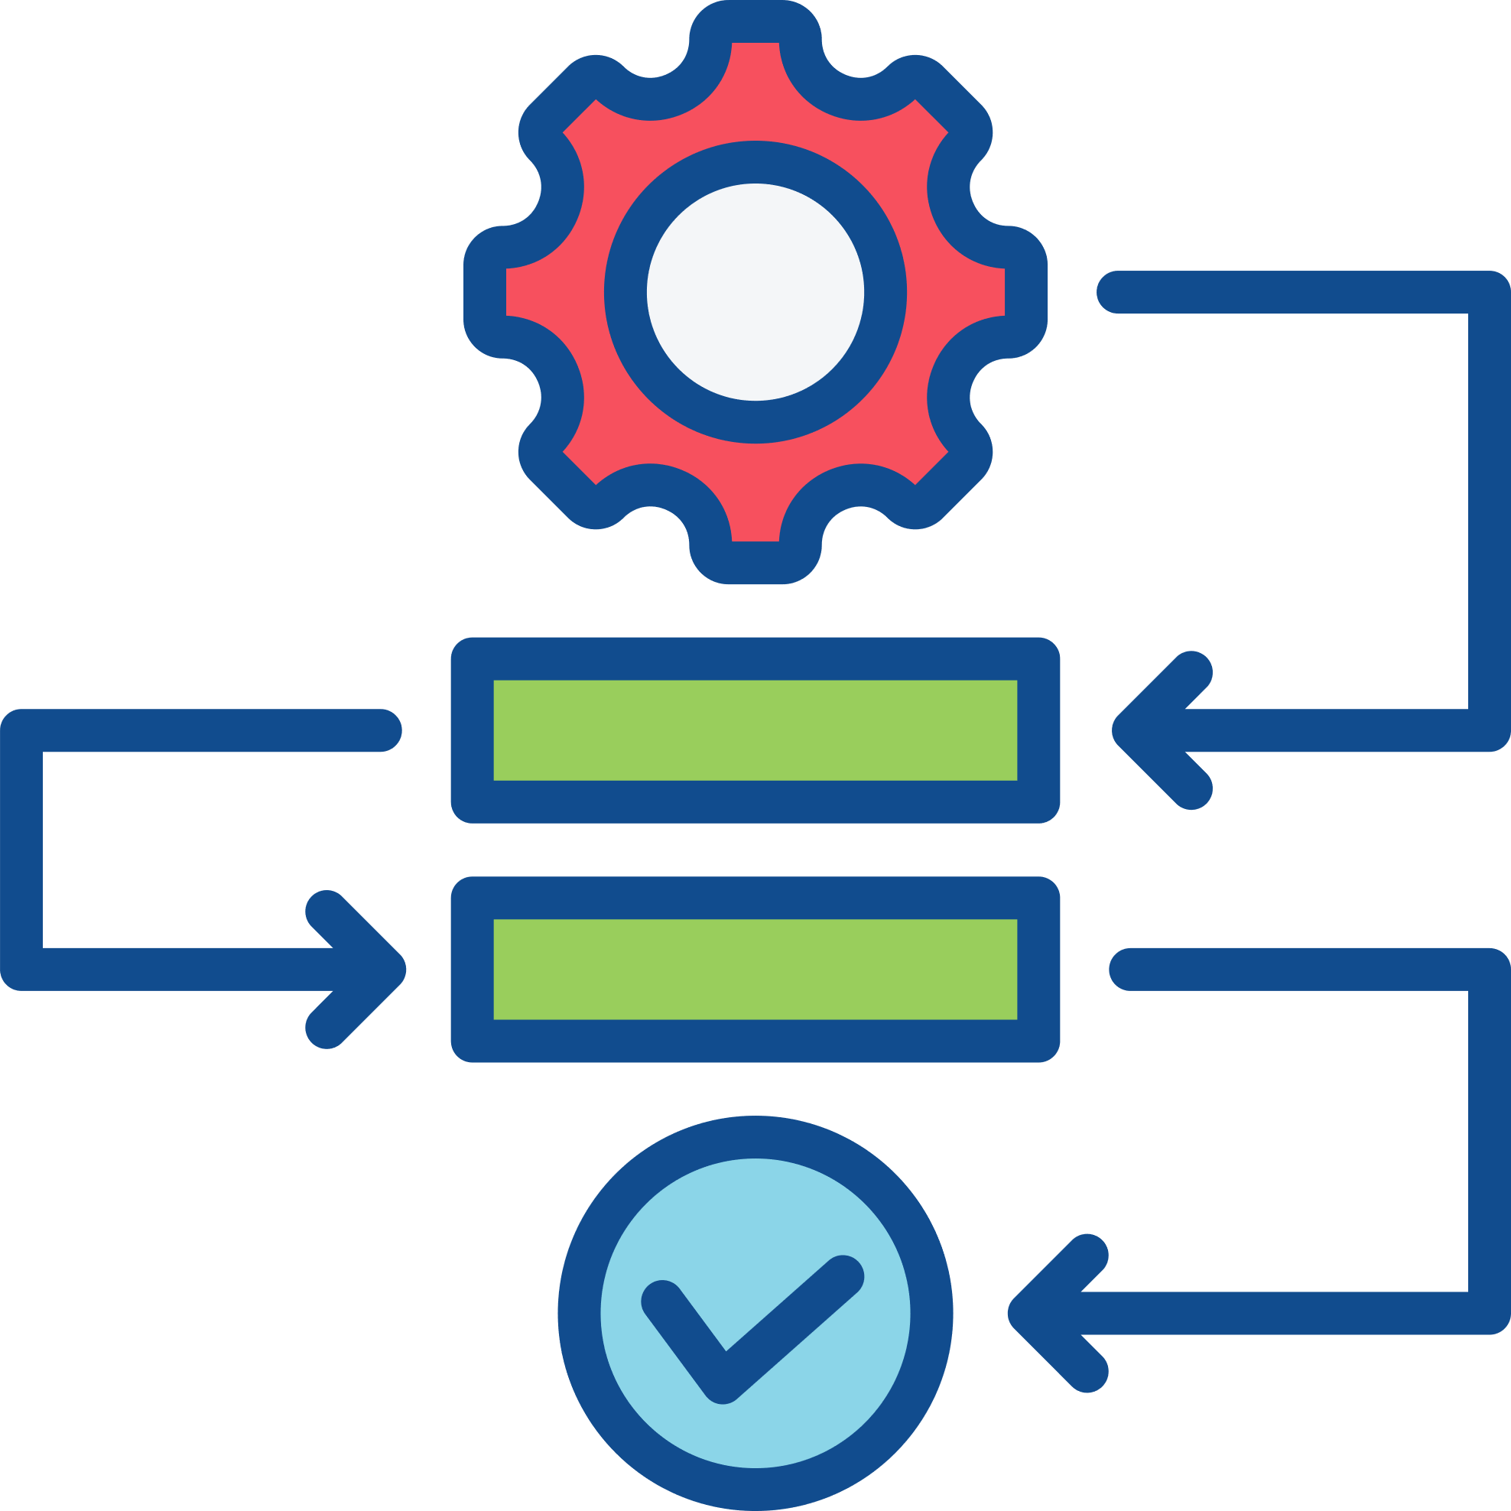



Environmental Sustainability
Environmental sustainability requires a culture change across the profession and supply chain.
Normalizing the subject of Environmental Sustainability.
Start with informal discussions to increase awareness and increasingly formalize into organizational/practice protocols and procedures (e.g., designate sustainability leads).
Translating personal, home-based attitudes and behaviours to the professional setting.
Apprehension and resistance to ES behaviour changes can be overcome by increasing awareness and identifying common ground and strength of feelings amongst colleagues.

Slide 8




Environmental Sustainability
Communicating effective and evidence-based prevention will benefit patients’ oral health and mitigate environmental impacts.
Increase patient awareness on the impact that good oral health has on them, society, and the environment.
Patients as co-creators and co-managers of their oral health.
Support patients to embed new oral health behaviours when they are ready to do so.
Motivate patients to take greater ownership for their own oral health, with an emphasis on home-based personal preventive regimes.
Increase patient awareness on the importance of preventive regimes that are tailored to their age and needs.

Slide 9


Environmental Sustainability
Avoid waste: high-quality and efficient patient care will mitigate environmental impacts.
Only use what is necessary by planning each patient encounter.
Focus on high-quality care by using fit-for-purpose materials and instruments that are grounded in evidence-based techniques.

Slide 10
The 4 Rs
(Reduce, Reuse, Recycle, Rethink)

Slide 11




Environmental Sustainability
Rethink – how can you optimize existing systems and processes to be more environmentally sustainable?
Use of digital technology for patient appointments, records, and electronic reminders.
Electronic credit card transfers and order forms.
Reduce paper use.
Engage with emerging scientific/technological changes to the profession.

Slide 12
Good Quality
Oral Healthcare

Slide 13



Environmental Sustainability
Good quality oral healthcare is…
Good for the patient
Good for the profession
Good for the environment

Slide 14







Environmental Sustainability
There is a need to take ownership of the care that you provide through lifelong learning to deliver high-quality clinical outcomes.
Effective clinical governance: review, reflect, and improve the quality of care you provide.
Engage with local networks, national organizations, and practice-based research.
Lead by example: set high standards, engage with the profession, make a difference, inspire others.
A professional that maintains knowledge and skills to a high standard is well placed to provide good quality care. Good quality care is environmentally sustainable care.
Learn and develop best practice: pursue a tailored programme of continued professional development (CPD).

Slide 15
Knowledge Exchange - Research

Slide 16



Environmental Sustainability
Developing a research curiosity will increase your levels of knowledge and awareness and may help mitigate the environmental impacts of oral healthcare.
Be aware and have knowledge of important environmental research methodologies including Life Cycle Assessments (LCA).
Identify and select high-quality evidence that considers not only clinical effectiveness but also economic feasibility and environmental sustainability.
Use current and strong evidence-based knowledge to guide your decision-making at all stages of care.

Slide 17
Environmental Sustainability
Evidence-based dentistry must consider the triple bottom line of
clinical effectiveness, cost-effectiveness, and environmental sustainability.
Be aware and have knowledge of important environmental research methodologies including Life Cycle Assessments (LCA).
Identify and select high-quality evidence that considers not only clinical effectiveness but also economic feasibility and environmental sustainability.
Use current and strong evidence-based knowledge to guide your decision-making at all stages of care.

Slide 18
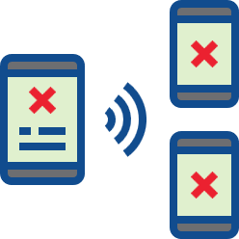

Environmental Sustainability
It is important to guard against misinformation and disinformation that may influence the objectivity of your decision-making.
There is confusion, misinformation, and disinformation in environmental sustainability that is influenced by the media and individual opinion.
Adopt a critical approach to all literature to avoid nonfactual and harmful information and agendas.

Slide 19
Policy and Regulations

Slide 20


Environmental Sustainability
Active engagement with environmental policies and regulations in oral healthcare will mitigate your environmental impact.
Engage with effective Antibiotic Stewardship.
Follow current regulations to handle, manage, and dispose of dental amalgam safely.
Adopt evidence-based clinical care guidelines to determine patient care pathways and follow-up appointments (e.g., Delivering Better Oral Health, NICE guidelines on recall intervals, European Federation of Periodontology guidelines).

Slide 21

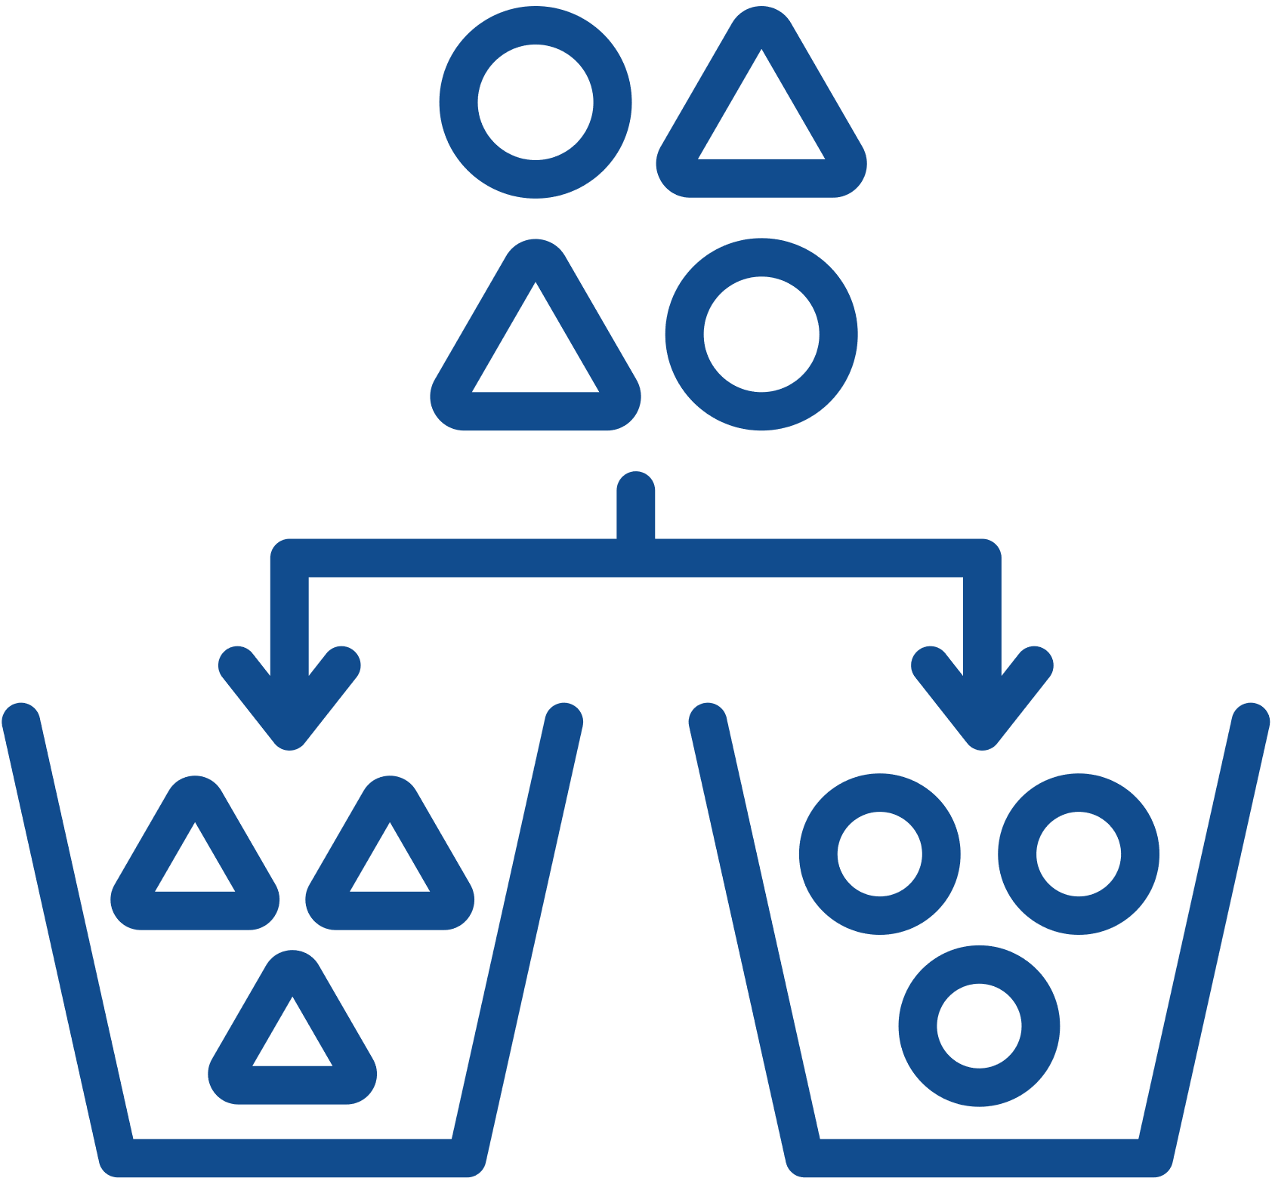
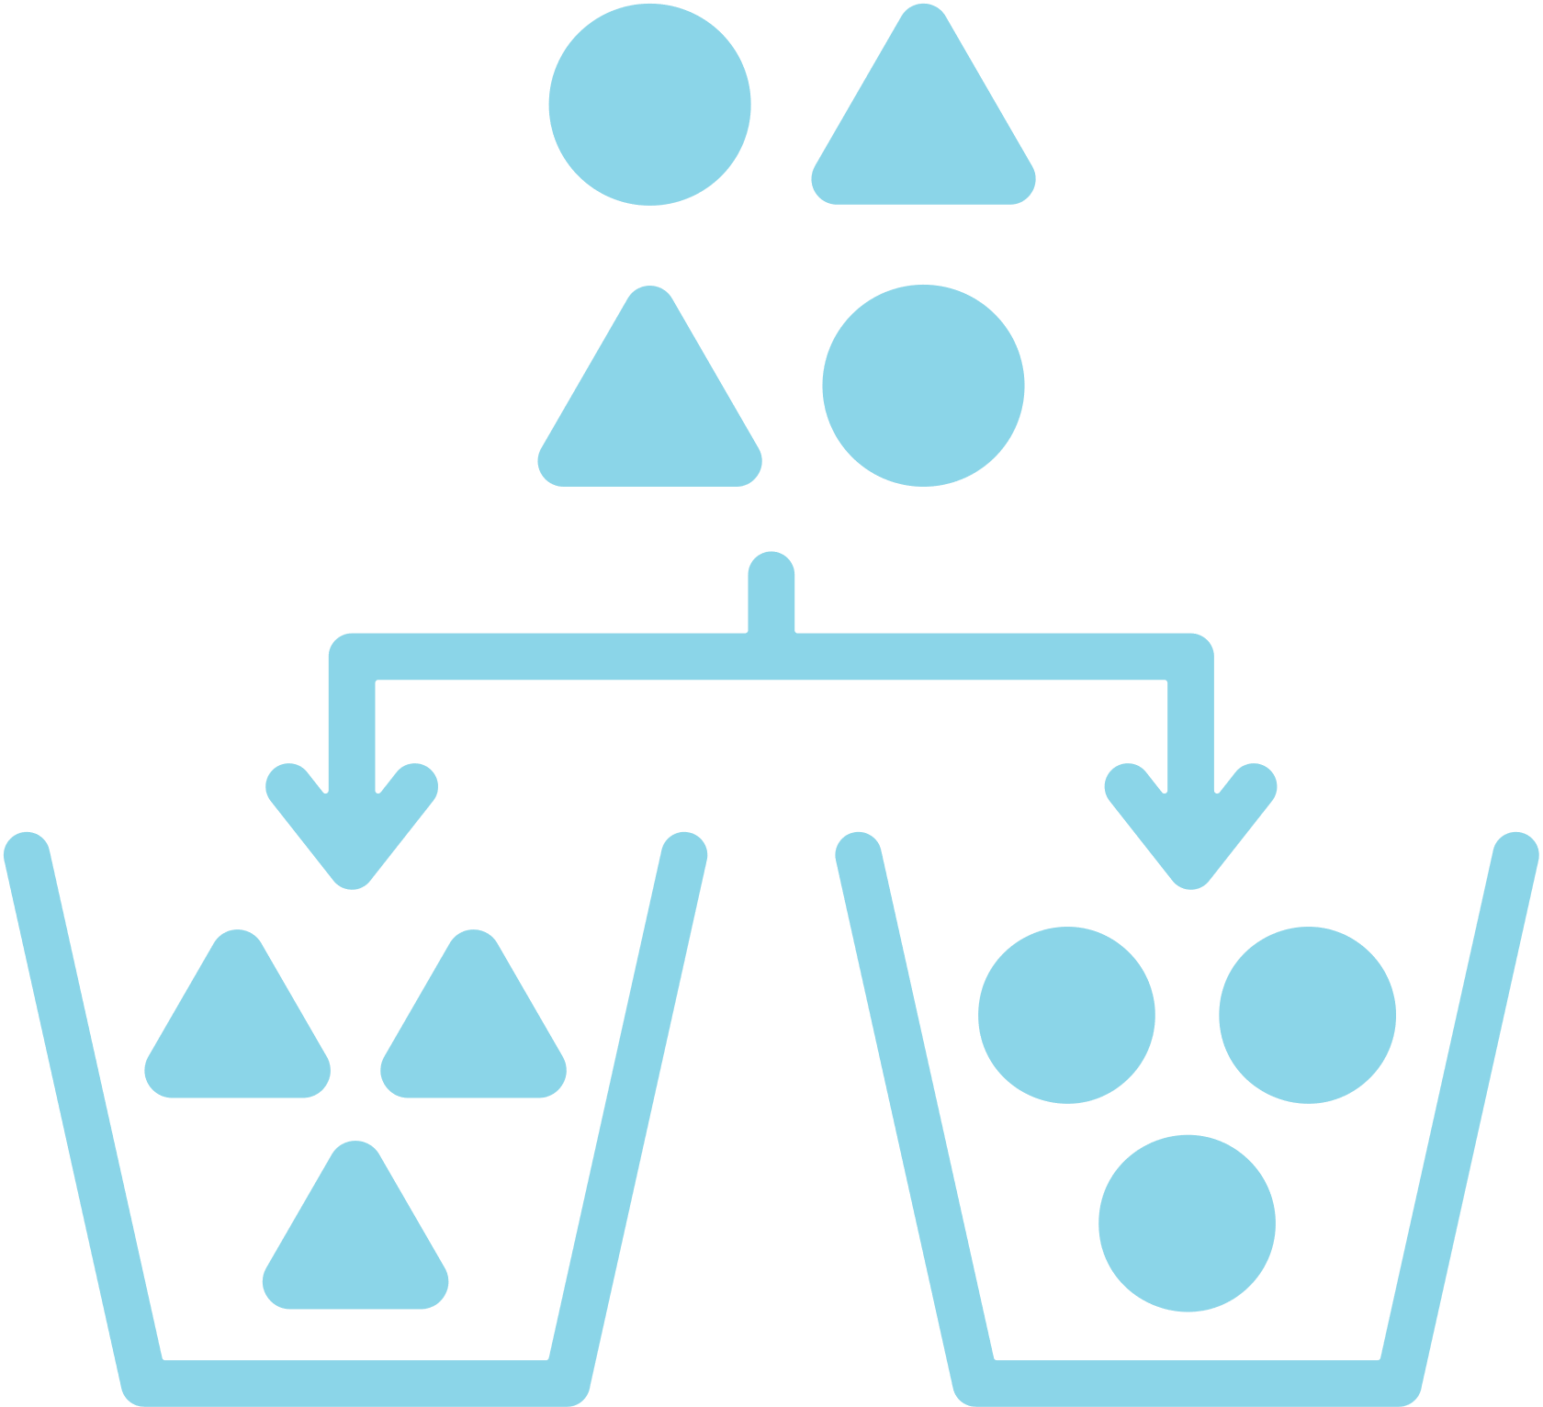
Environmental Sustainability
Active engagement and collaboration with policymakers will lead to the development of more environmentally sustainable oral healthcare policies.
Promote innovative ways to maintain high-quality care delivery whilst mitigating environmental impacts.
Engage with municipal waste management and collection services to further mitigate impacts (e.g., waste separation, recycling, energy recovery incineration).
Challenge the status quo at a local level within the workplace (e.g., laboratories, reception, common room, waste segregation).

Slide 22
Procurement

Slide 23




Environmental Sustainability
Engaging and challenging stakeholders across the supply chain will support environmentally sustainable practices.
Work and engage with suppliers to assess their sustainability practices.
Apply pressure to suppliers to act in an environmentally sustainable manner.
Request recycling information for medical equipment from manufacturers.
Identify locally produced items and coordinate with local suppliers to reduce travel.
Reducing and reusing packaging.

Slide 24



Sustainability in Dentistry MOOCs
MOOC 2
Practical Applications of Sustainability in Dentistry
Understand how to implement sustainable practices using the FDI Sustainability Toolkit and other resources and guidance.
MOOC 1
Sustainability in Dentistry
Discover the impact of oral healthcare on the environment and the basic concepts of sustainable practice.

Slide 25
Acknowledgements
Slides
Thank you to Dr. Jonathan Dixon (Clinical Academic Fellow in Restorative Dentistry) for supporting the development of these slides and associated resources, under the supervision of Prof. Nicolas Martin (Clinical Professor in Restorative Dentistry).
Research
Thank you to the authors of the research paper identifying a comprehensive strategy for the inclusion and delivery of Environmental Sustainability in the curriculum.
Dixon, J., Field, J., Gibson, E., and Martin, N. (2024). Curriculum content for Environmental Sustainability in Dentistry. Journal of Dentistry, 147, 105021. doi: https://doi.org/10.1016/j.jdent.2024.105021
Martin, N. and Mulligan, S. (2022). Environmental Sustainability Through Good-Quality Oral Healthcare. International Dental Journal. doi: https://doi.org/10.1016/j.identj.2021.06.005
Task Team
Thank you to the Sustainability in Dentistry Task Team for providing guidance and scientific expertise to ensure sound implementation of the entire Sustainability in Dentistry Project. The team includes:
Chair: Prof. Nicolas Martin (United Kingdom)
Members:
  Dr. Steven Mulligan (United Kingdom)
  Asst. Prof. Duygu Ilhan (Türkiye)
  Asst. Prof. Hasan Jamal (Saudi Arabia)
  Asst. Prof. Donna Hackley (United States of America)
  Dr. Mick Armstrong (United Kingdom)

Slide 26






Partners and Supporters
The Sustainability in Dentistry project is supported by our Partners and Sponsors:
Partners
Supporters

