Slide 1
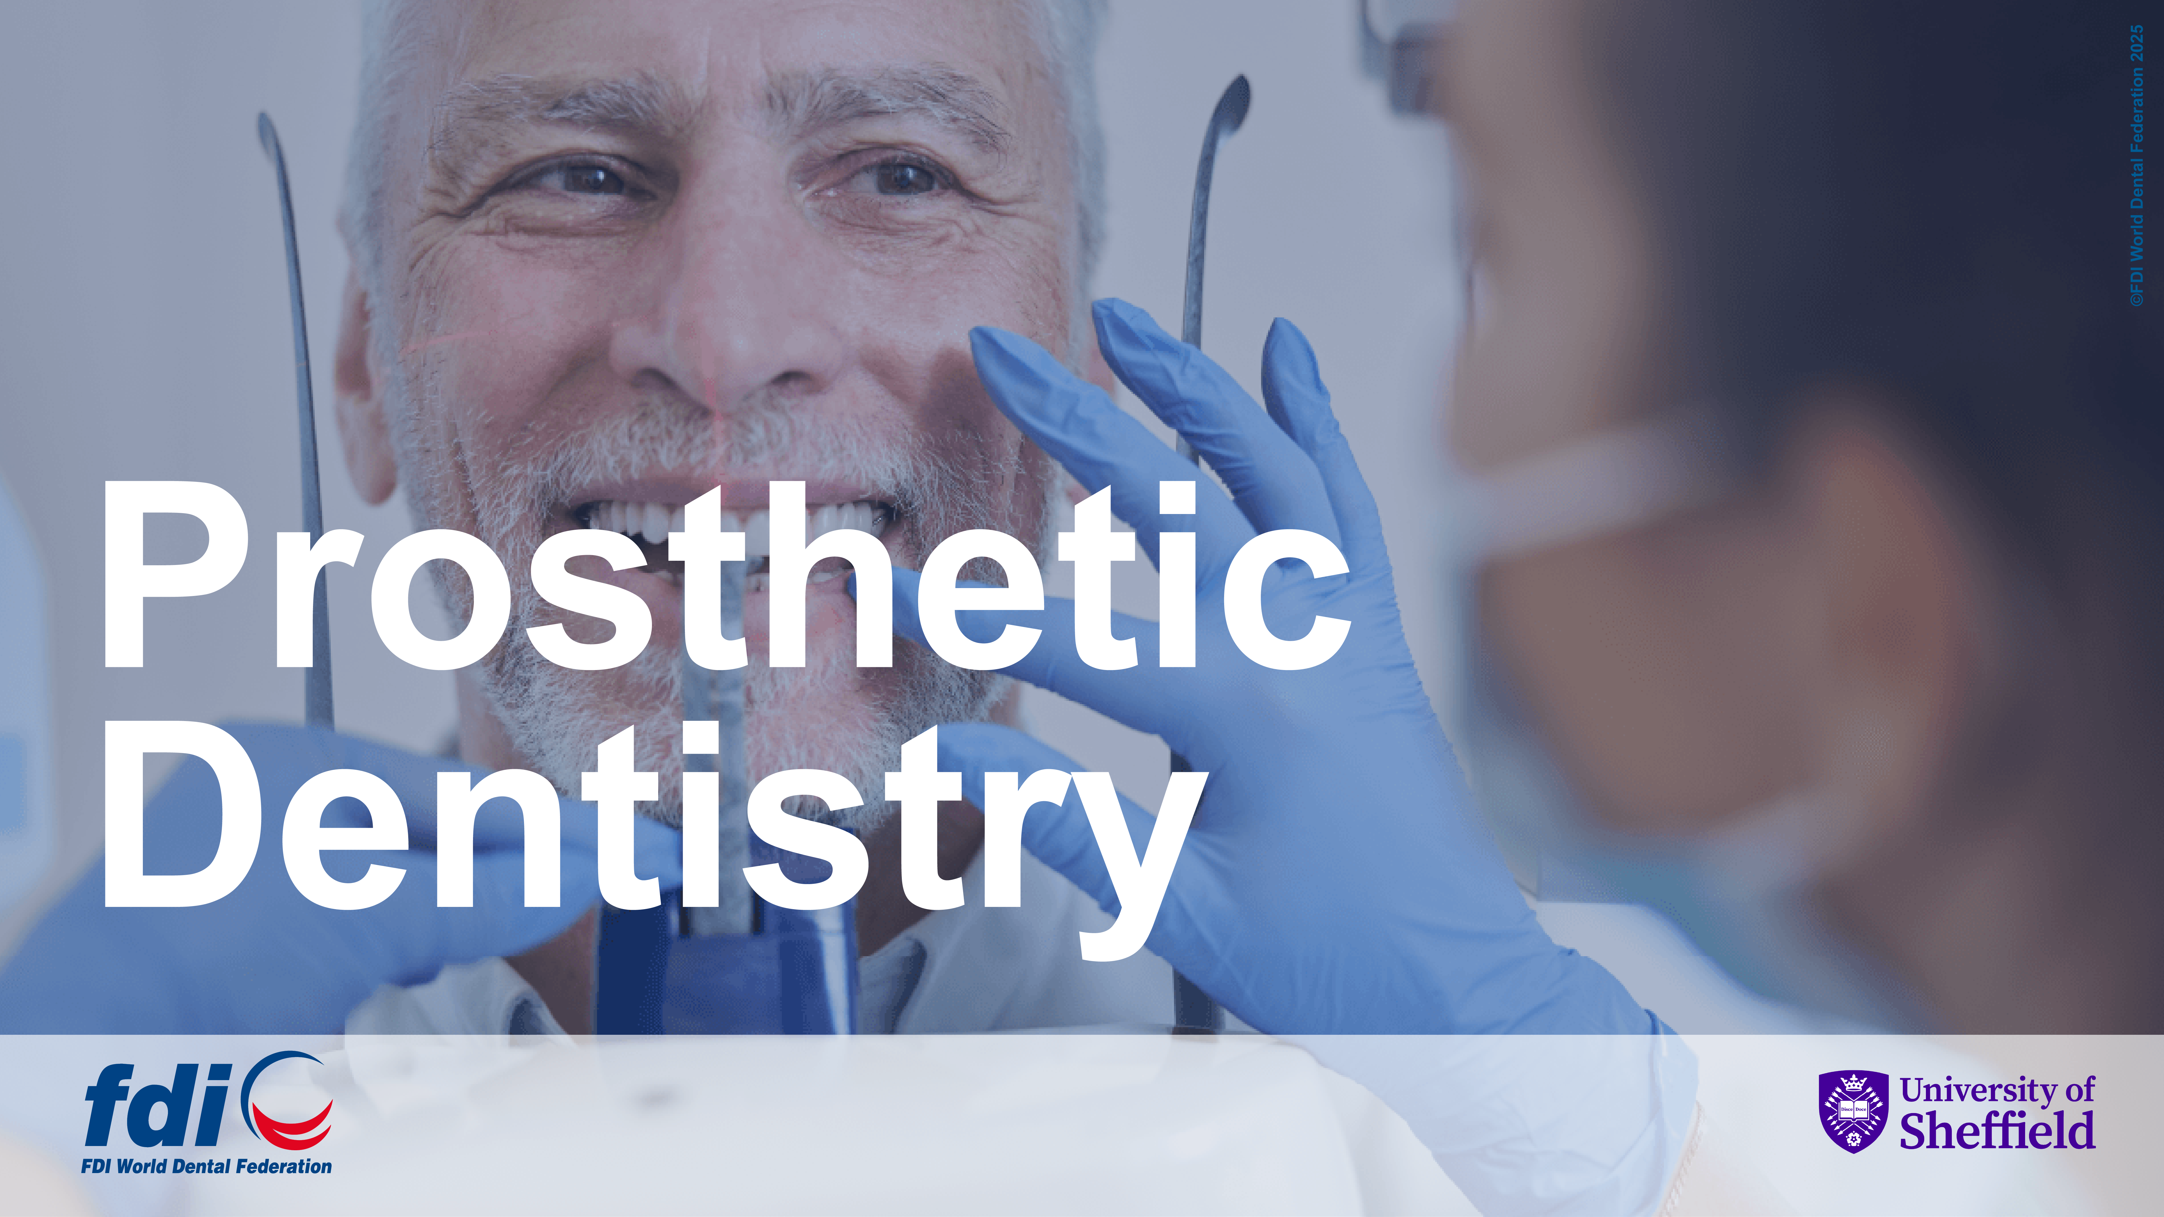

Slide 2

Raising awareness of the Environmental Impact of Dentistry

Slide 3




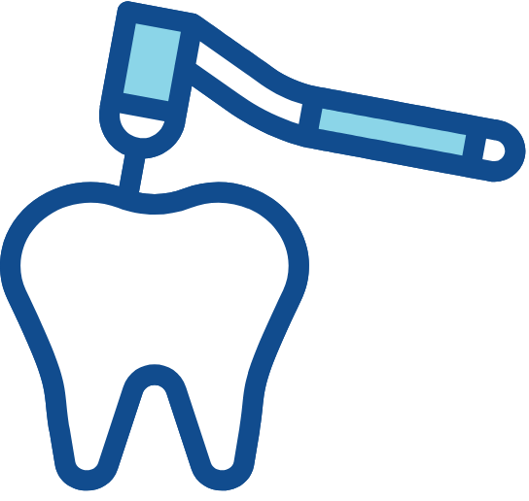

Environmental Sustainability
The provision of professionally delivered oral healthcare results in
significant environmental impacts from:
staff commute and patient travel;
the product supply chain and management of waste from the dental practice.
These environmental impacts are inversely related to the oral health and disease risk status of the individual.
That is, good oral health equates to minimal environmental impacts.
Good oral health requires fewer operative interventions, with a consequential reduction of all environmental impacts (Staff commute and patient travel; as well as the manufacturing, distribution, and waste management of materials and sundries used in the dental practice.)

Slide 4






Environmental Sustainability
Personal oral hygiene regimes have inevitable ‘baseline’ environmental impacts. These impacts arise from the product supply chain and disposal of oral hygiene products and devices.
Environmental impacts that arise from effective personal care preventive regimes are an inevitable consequence of maintaining good oral health.
The impacts from the use of personal products and devices (e.g., toothbrush, dentifrice, interdental cleaning aids, mouthwashes) are much lower than that from the delivery of professional interventive care. Principally, because the patient is not travelling to a remote location (dental practice) and the number of these home-care products is significantly so much smaller than those used in a dental practice.
The paradigm between the ES impacts from dental practice and home care is a good example of why the impacts cannot be eliminated and can only be mitigated.

Slide 5


Environmental Sustainability
It is imperative to promote and maintain good oral health through the prevention of oral diseases. An effective preventive regime carries an environmental burden that is much smaller than a disease-driven interventive treatment approach.
Prevention of preventable diseases and conditions including dental caries, periodontal disease, pulpal disease, tooth surface loss, and oral cancers.
Follow evidence-based guidelines for professional delivery of oral healthcare and the promotion of personal oral health regimes.
UK and European examples include:
  NICE guidelines for recall intervals based on oral disease risk.
  Delivering Better Oral Health: an evidence-based toolkit for prevention.
  EFP guidelines on the clinical management of stage I-III periodontitis.

Slide 6





Environmental Sustainability
There is a need to influence and educate the profession and the public on strategies to mitigate the environmental impacts of oral healthcare.
Patient information leaflets and promotion through social media.
The conduct, promotion, and delivery of quality care that is evidence-driven.
Integration of ES messages into all aspects of oral healthcare.
External continuing professional development activities.
A strong focus on patient engagement and ownership of own oral healthcare, with an emphasis on home-based personal preventive regimes.
Emphasize that the provision and maintenance of good oral health is good for the patient, good for society, and the single best way of mitigating environmental impacts from oral healthcare.
In-house staff training on Environmental Sustainability, as a part of normal professional development.

Slide 7




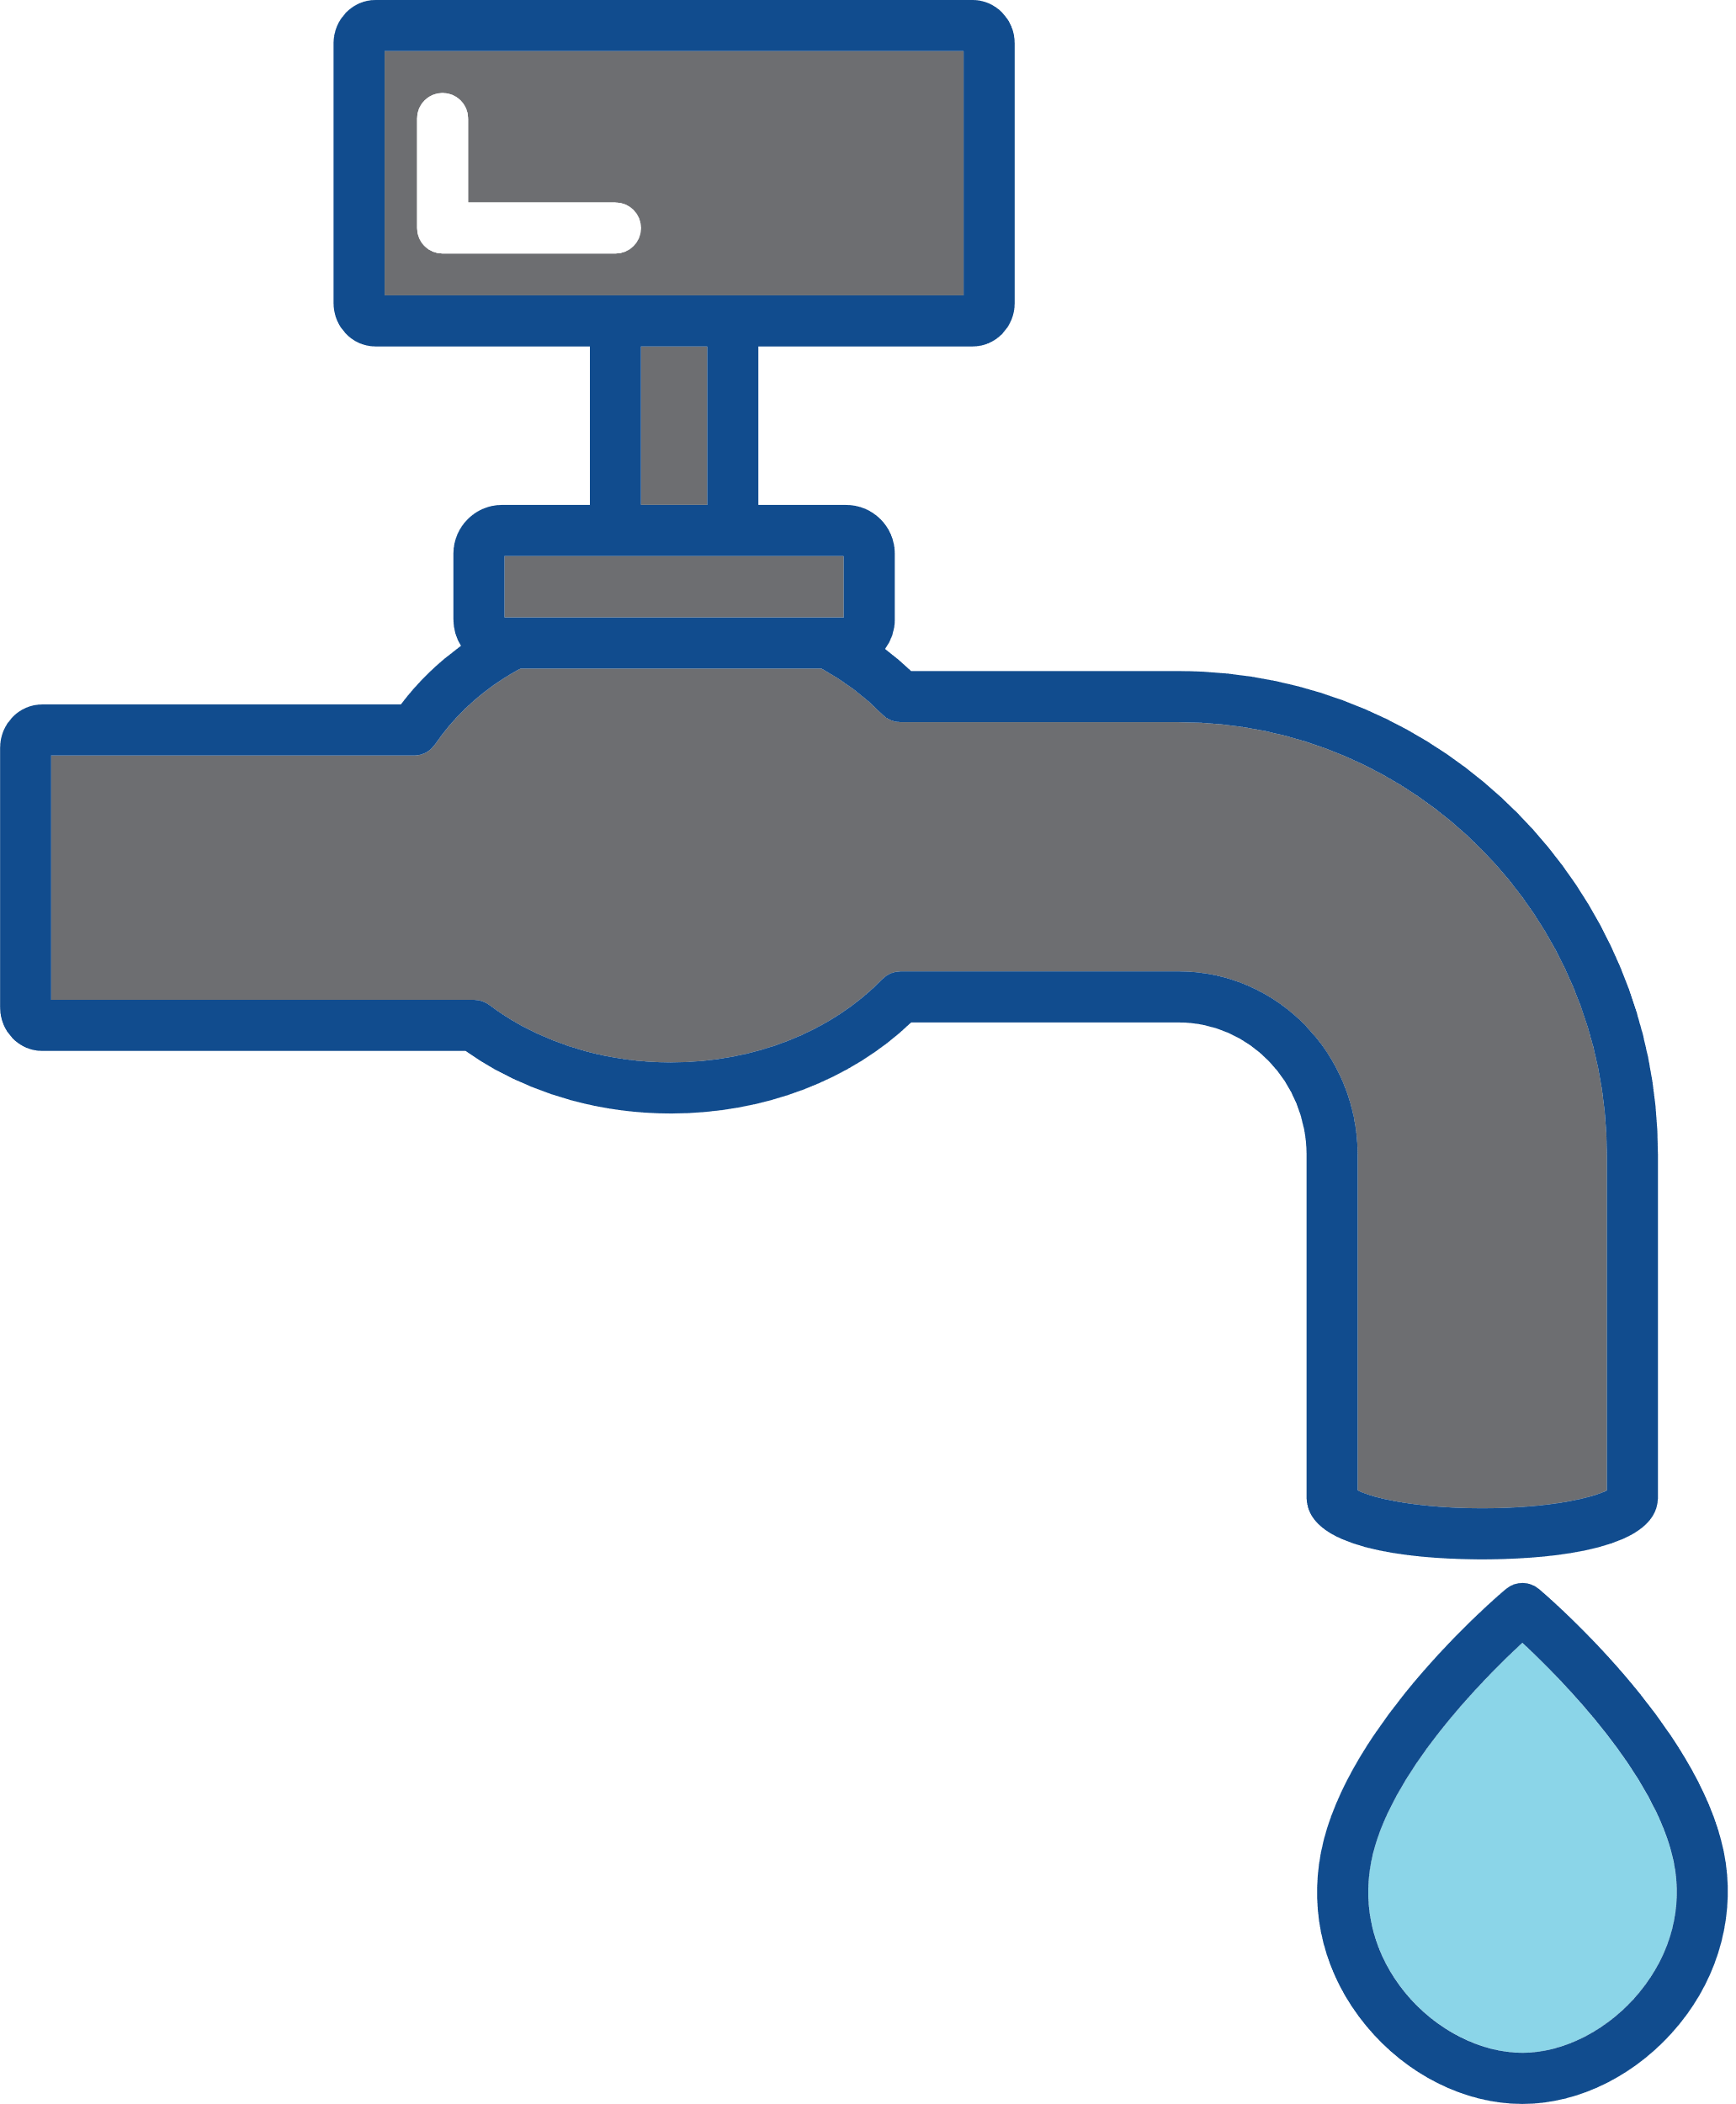
Environmental Sustainability
The single most effective strategy to improve environmental sustainability in oral healthcare is through disease prevention. This will result in less travel, less use of resources, and less waste generation.
Promote effective preventive strategies for all patients, tailored to their age and needs.
Reduce the frequency and consumption of sugars and acidic drinks.
Promote toothbrushing
and fluoridation.
Encourage dental attendance and risk-based maintenance schedules.
Promote a reduction in alcohol consumption and tobacco cessation.
Where appropriate and feasible, water fluoridation should be considered as a community approach for the prevention of caries.
Adopting a minimal intervention approach to oral healthcare.

Slide 8

Behaviour Change

Slide 9

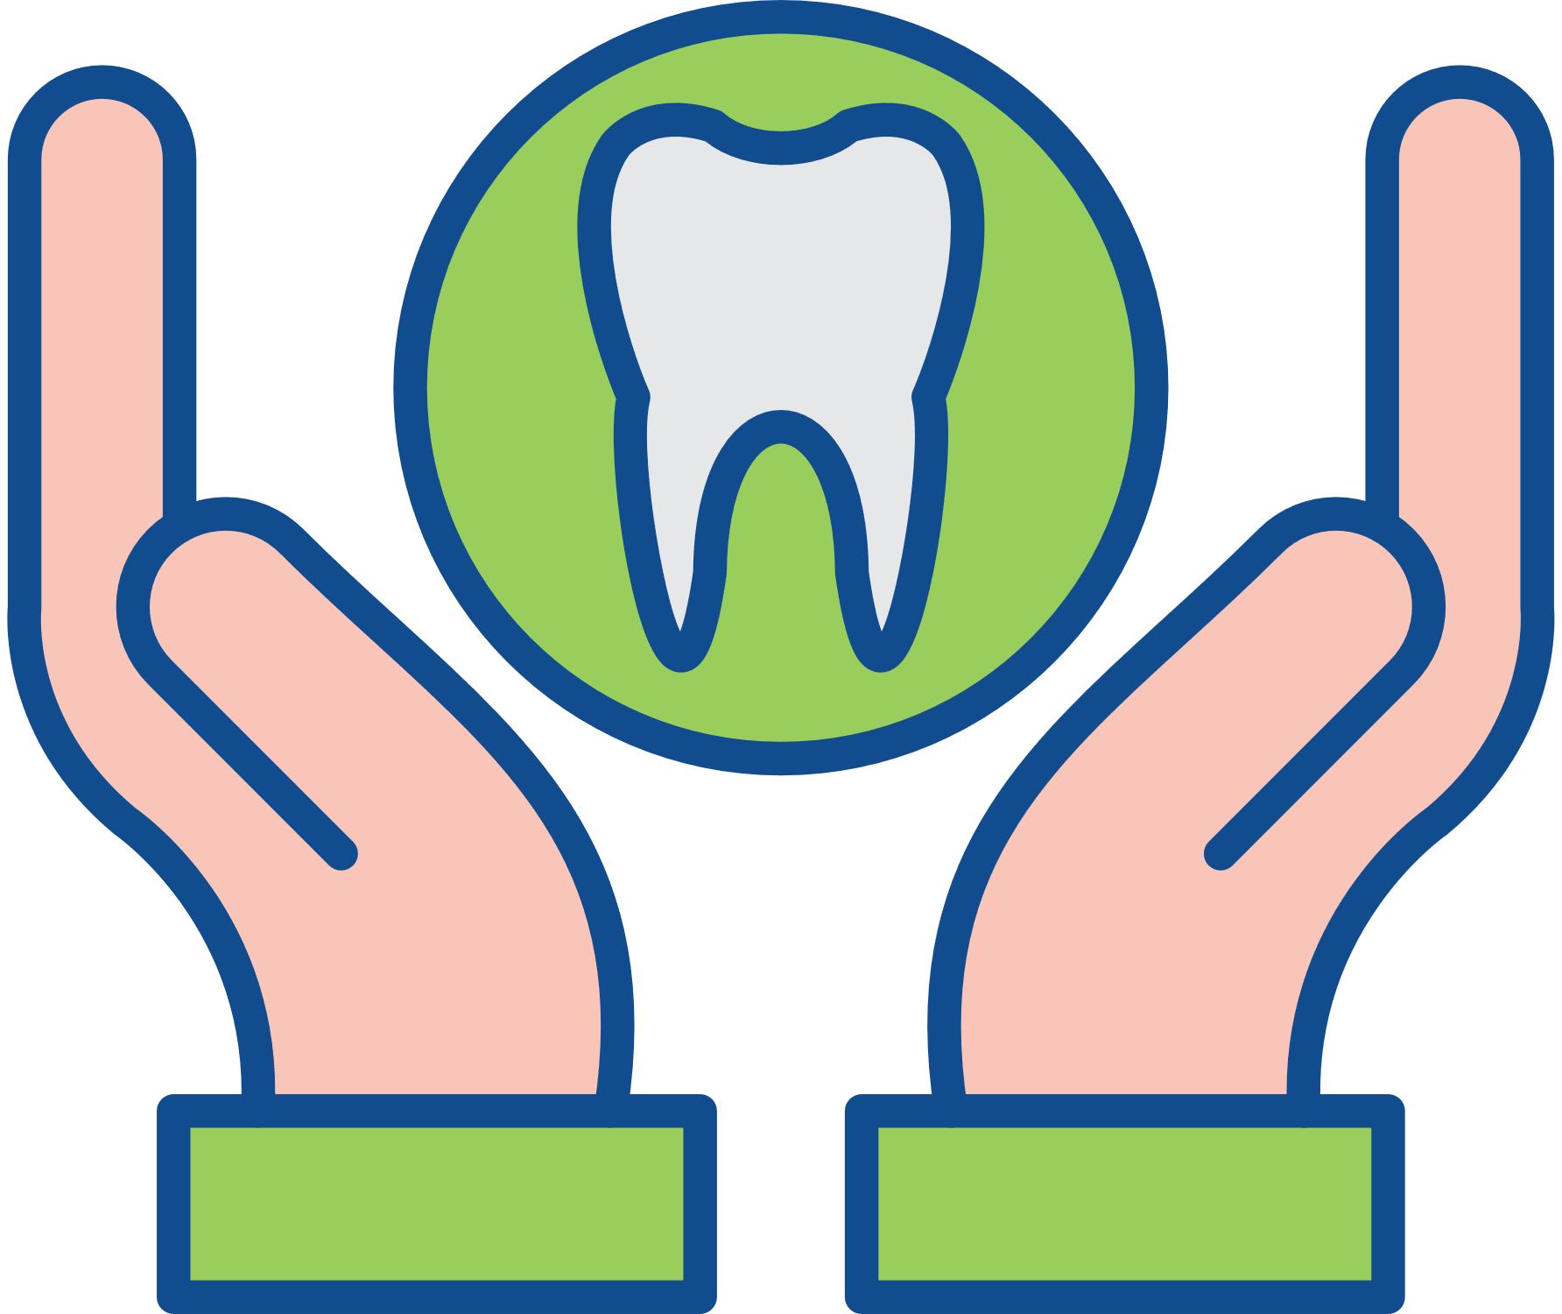



Environmental Sustainability
Communicating effective and evidence-based prevention will benefit patients’ oral health and mitigate environmental impacts.
Increase patient awareness on the impact that good oral health has on them, society, and the environment.
Patients as co-creators and co-managers of their oral health.
Support patients to embed new oral health behaviours when they are ready to do so.
Motivate patients to take greater ownership for their own oral health, with an emphasis on home-based personal preventive regimes.
Increase patient awareness on the importance of preventive regimes that are tailored to their age and needs.

Slide 10
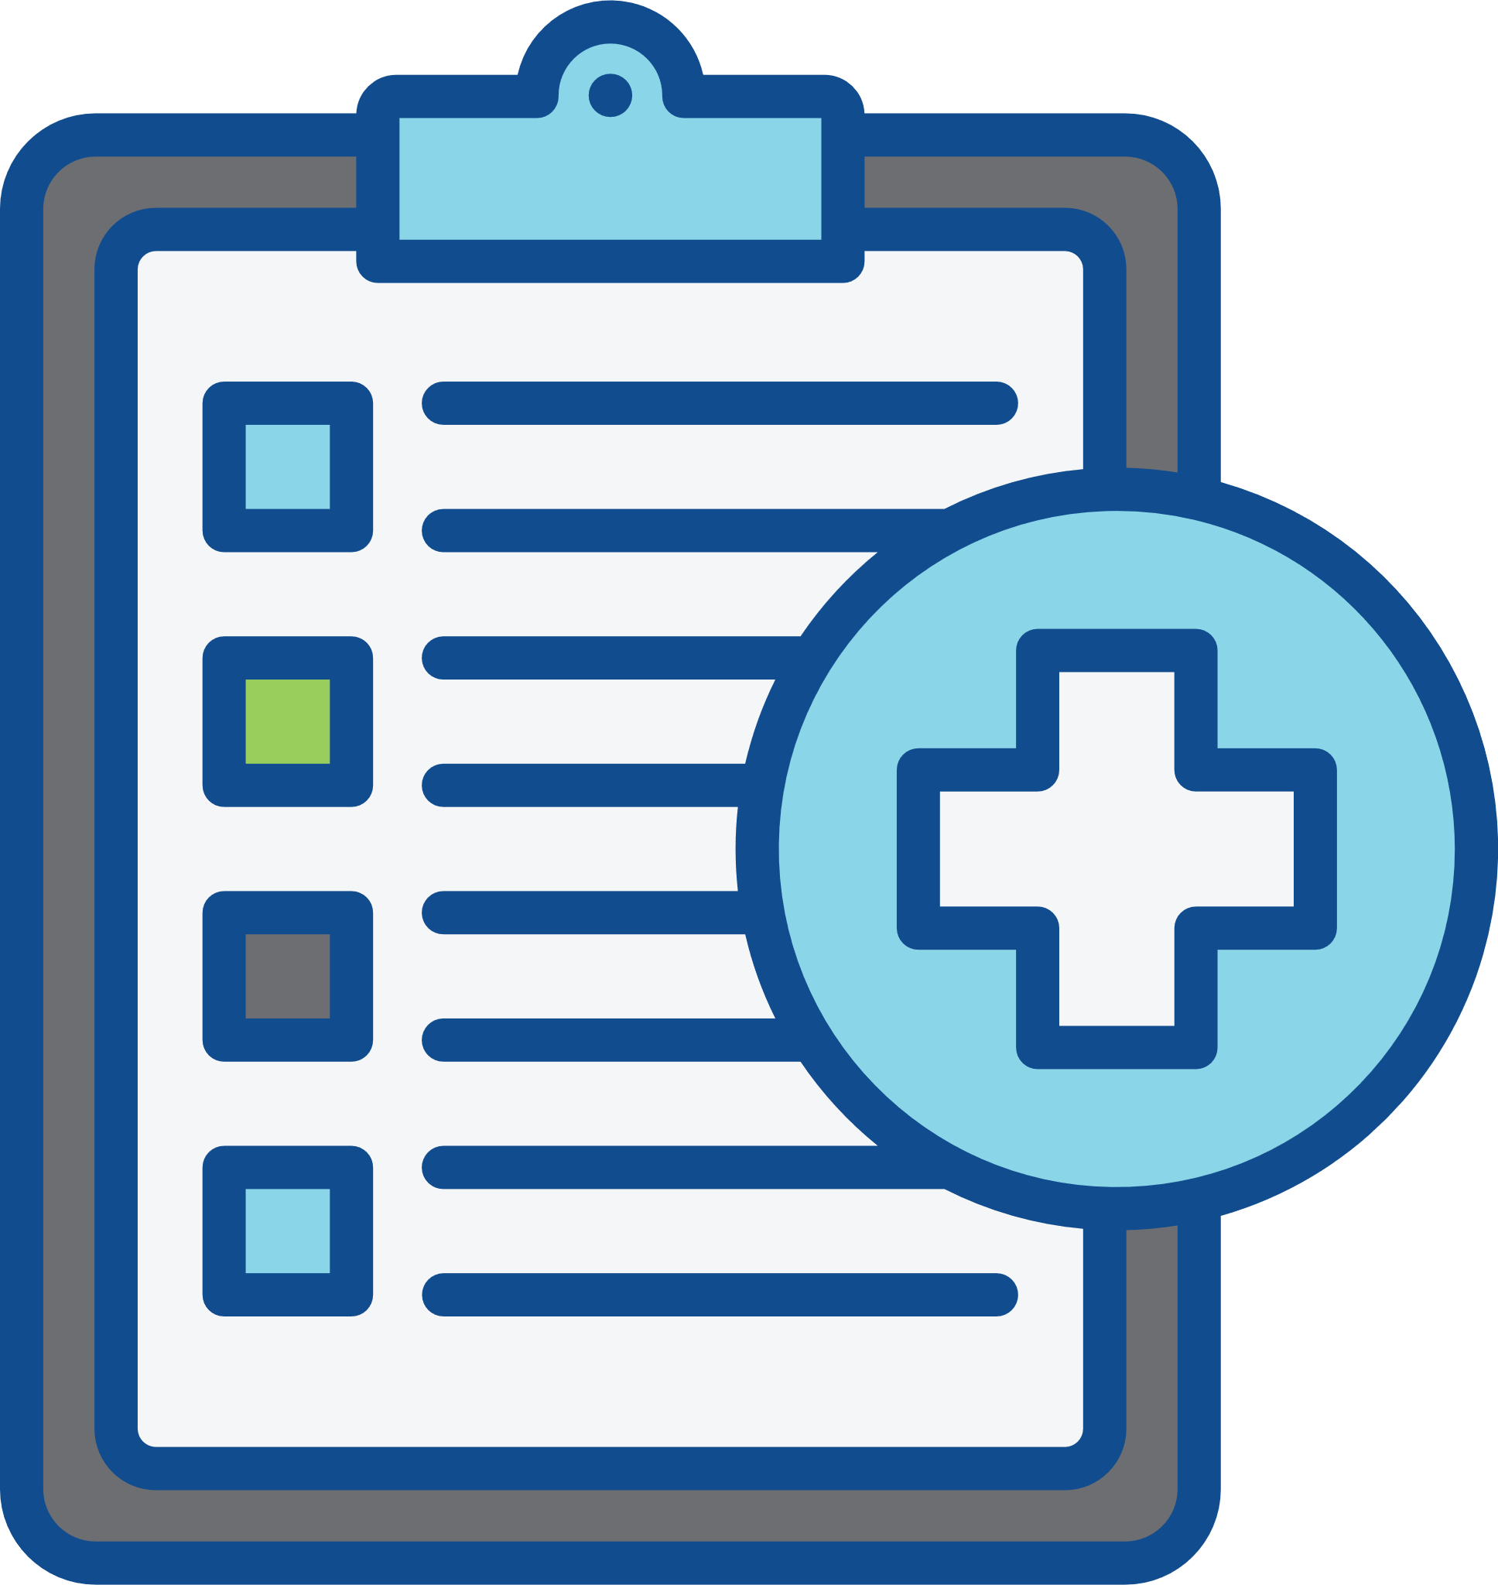

Environmental Sustainability
Avoid waste: high-quality and efficient patient care will mitigate environmental impacts.
Only use what is necessary by planning each patient encounter.
Focus on high-quality care by using fit-for-purpose materials and instruments that are grounded in evidence-based techniques.

Slide 11
The 4 Rs
(Reduce, Reuse, Recycle, Rethink)

Slide 12

Environmental Sustainability
Delivering a prevention-focused, patient-centred, high-quality oral health care service will reduce treatment need and the resultant environmental impact.
The best way to mitigate the environmental impacts from oral healthcare provision is through a reduction of the ‘need to treat’, which is best achieved through the prevention of preventable diseases and the delivery of high-quality care.
A reduction of ‘need to treat’ results in a reduced need to use resources, energy, and waste generation at all points of the oral healthcare supply chain.

Slide 13



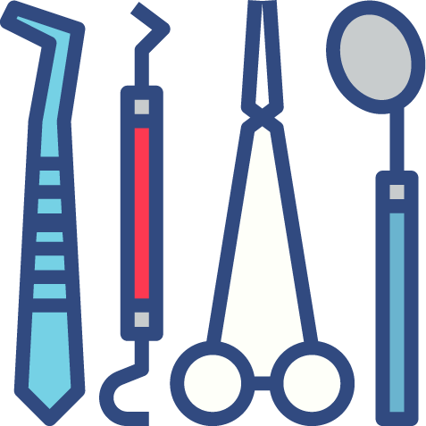
Environmental Sustainability
Use reusable options where appropriate.
Use of cloth fabric alternatives to SUPs, including clothes, barriers, and cleaning items.
Reusable PPE: laboratory coats to replace aprons, reusable face shields, and patient bibs.
Use of washable cups, dishes, and cutlery.
Reusable instruments (impression trays, suction tips, matrix band retainers).

Slide 14
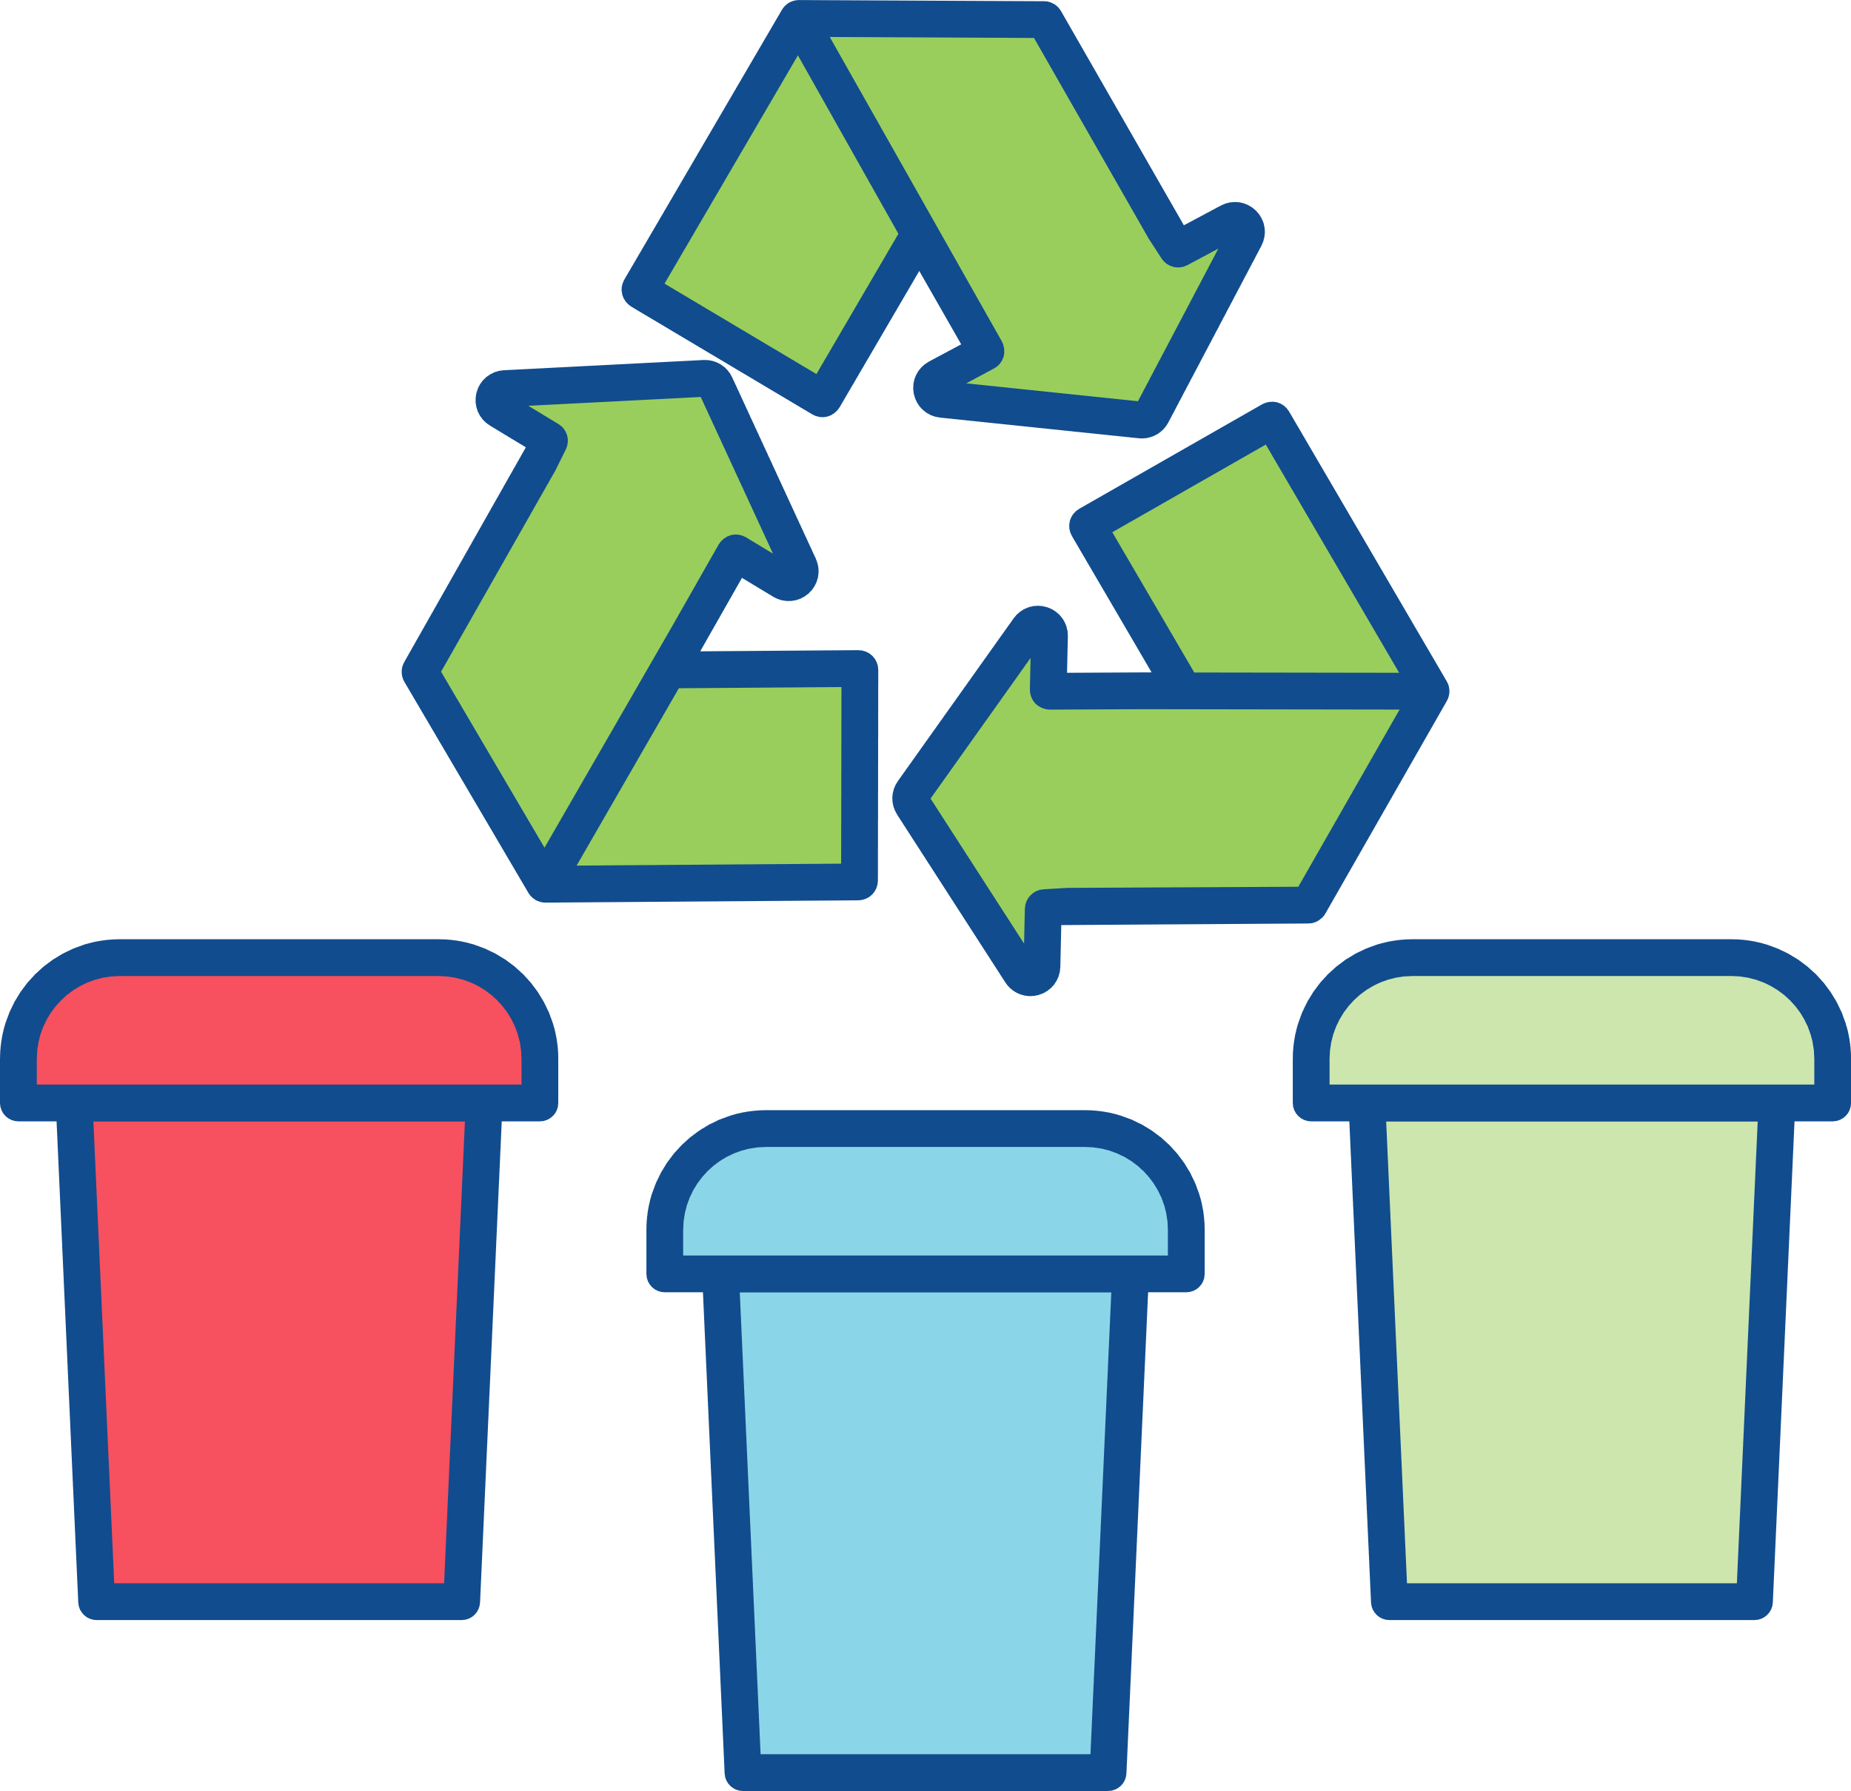





Environmental Sustainability
A shift from a wasteful linear economy to a more sustainable circular economy in oral
healthcare is possible by proactively seeking and implementing recycling opportunities.
Segregate your waste and recycle.
Ensure your items are recyclable, quality over quantity.
Improve awareness and liaise with local authorities and support groups.
Identify and use pre-existing community recycling programmes to recycle separated paper and plastic parts of autoclavable bags and packaging.
Recycle office waste such as plastics, paper and medical shredding, and printer cartridges.

Slide 15
Good Quality
Oral Healthcare

Slide 16



Environmental Sustainability
Good quality oral healthcare is…
Good for the patient
Good for the profession
Good for the environment

Slide 17


Environmental Sustainability
A reduction in the need for professional-led interventions is achieved through disease prevention. This is the single most environmentally sustainable measure.
A reduction of ‘need to treat’ reduces waste generation and the need to use energy and resources at all points of the oral healthcare supply chain.
The provision of oral healthcare in all settings should focus on the fundamental messages of oral health promotion and disease prevention.

Slide 18

Environmental Sustainability
High-quality operative care reduces repair, replacement, and waste.
Adopting evidence-based practices to achieve high-quality and durable clinical outcomes.
Establish protocol-driven patient-care practices to drive reproducibility of high-quality and durable outcomes.
Careful selection and use of dental materials, instruments, and equipment in accordance with the manufacturer’s ‘Directions for Use’.

Slide 19
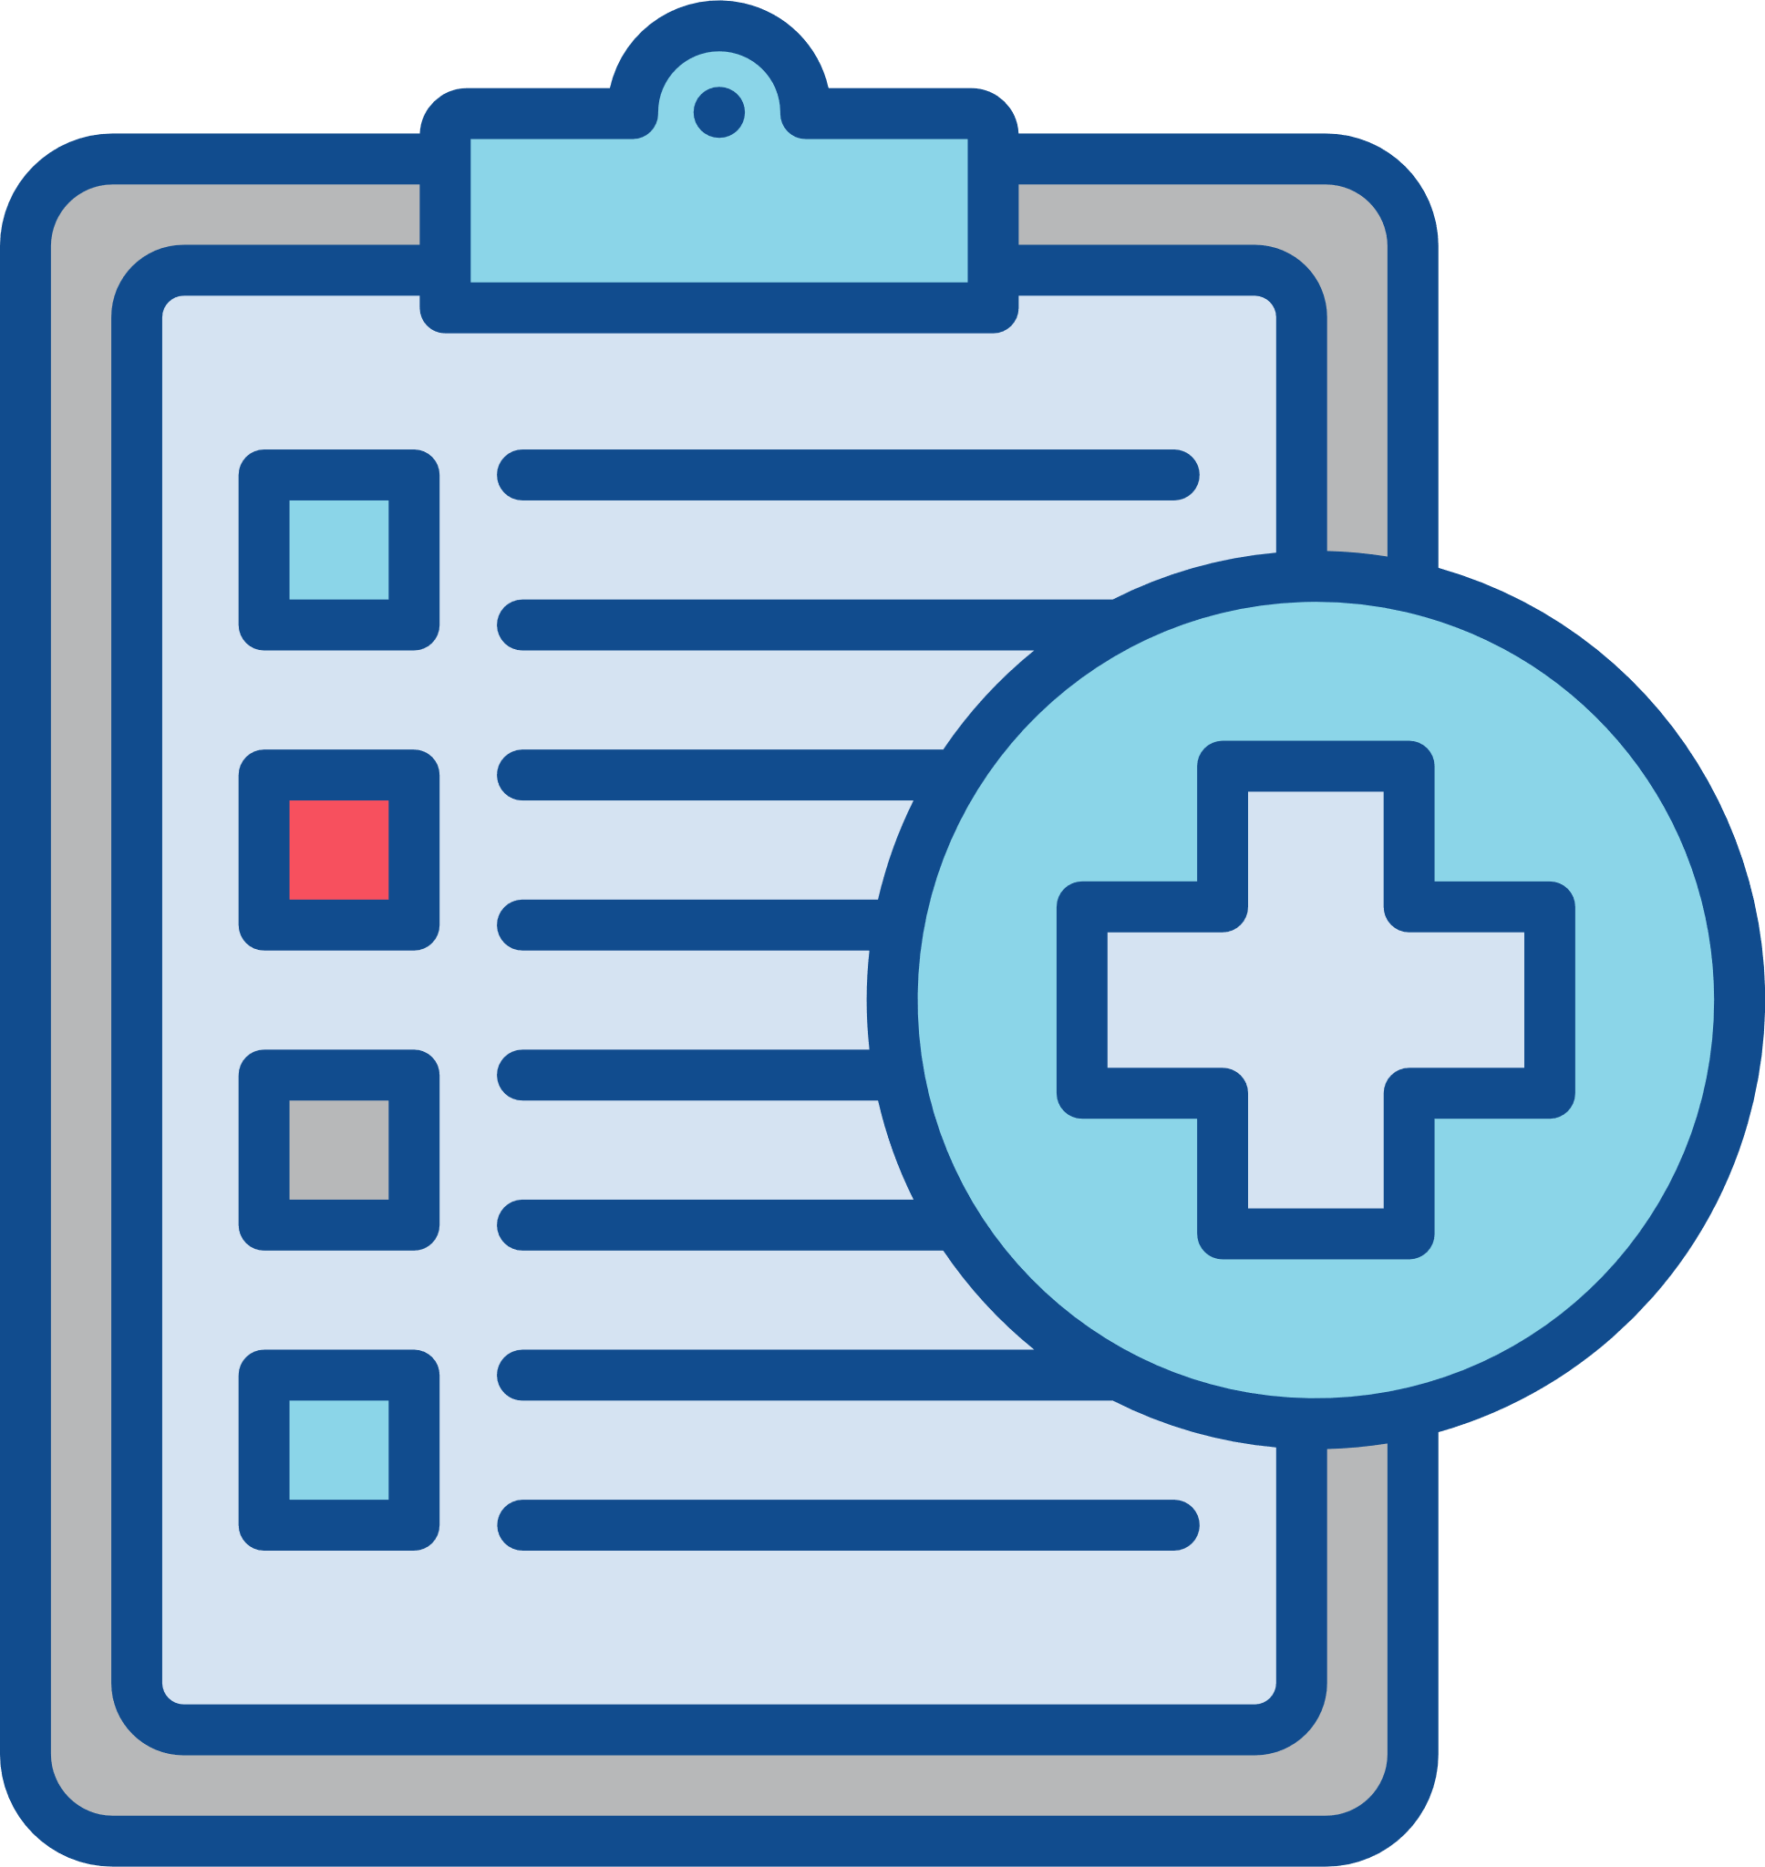





Environmental Sustainability
Integrated healthcare services with patients as co-managers of their care mitigate environmental impacts.
Structured treatment plans that are professional-led with joint ‘patient-professional’ responsibility for delivery.
Support patients to be co-managers of their oral healthcare: Active participation in decision-making, treatment, and maintenance.
Smart treatment planning to reduce the number of appointments.
Integration with wider healthcare services to facilitate a multi-disciplinary approach to patient care.

Slide 20






Environmental Sustainability
There is a need to take ownership of the care that you provide through lifelong learning to deliver high-quality clinical outcomes.
Effective clinical governance: review, reflect, and improve the quality of care you provide.
Engage with local networks, national organizations, and practice-based research.
Lead by example: set high standards, engage with the profession, make a difference, inspire others.
A professional that maintains knowledge and skills to a high standard is well placed to provide good quality care. Good quality care is environmentally sustainable care.
Learn and develop best practice: pursue a tailored programme of continued professional development (CPD).

Slide 21
Knowledge Exchange - Research

Slide 22


Environmental Sustainability
Evidence-based dentistry must consider the triple bottom line of
clinical effectiveness, cost-effectiveness, and environmental sustainability.
Be aware and have knowledge of important environmental research methodologies including Life Cycle Assessments (LCA).
Identify and select high-quality evidence that considers not only clinical effectiveness but also economic feasibility and environmental sustainability.
Use current and strong evidence-based knowledge to guide your decision-making at all stages of care.

Slide 23
Policy and Regulations

Slide 24
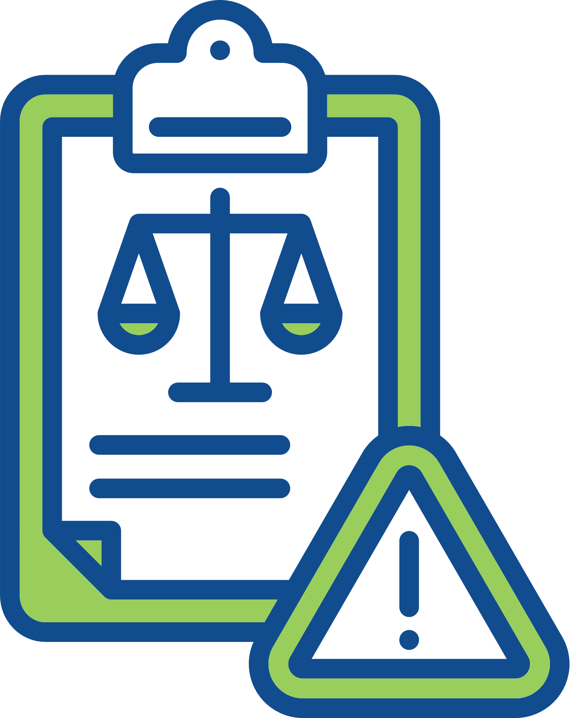

Environmental Sustainability
Active engagement with environmental policies and regulations in oral healthcare will mitigate your environmental impact.
Engage with effective Antibiotic Stewardship.
Follow current regulations to handle, manage, and dispose of dental amalgam safely.
Adopt evidence-based clinical care guidelines to determine patient care pathways and follow-up appointments (e.g., Delivering Better Oral Health, NICE guidelines on recall intervals, European Federation of Periodontology guidelines).

Slide 25
Travel

Slide 26
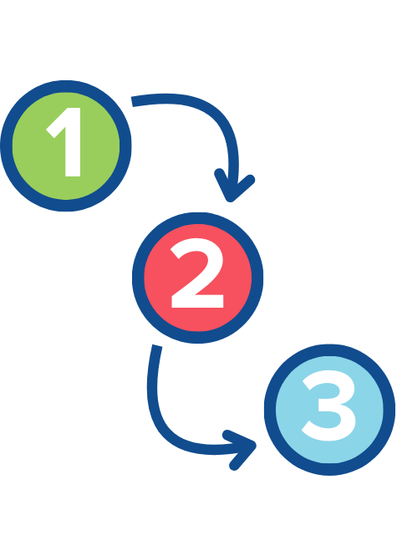



Environmental Sustainability
Planning patient care to reduce the number of appointments will mitigate the environmental impact of the care you provide.
Reduce the number of appointments by providing multiple procedures in one visit.
Engage with Tele-dentistry and Remote Clinical Consultations to reduce travel.
Combine family appointments wherever possible.
Using digital technologies (CAD-CAM, intra-oral scanning, 3D printing) will reduce the number of appointments and transport to dental laboratories.

Slide 27


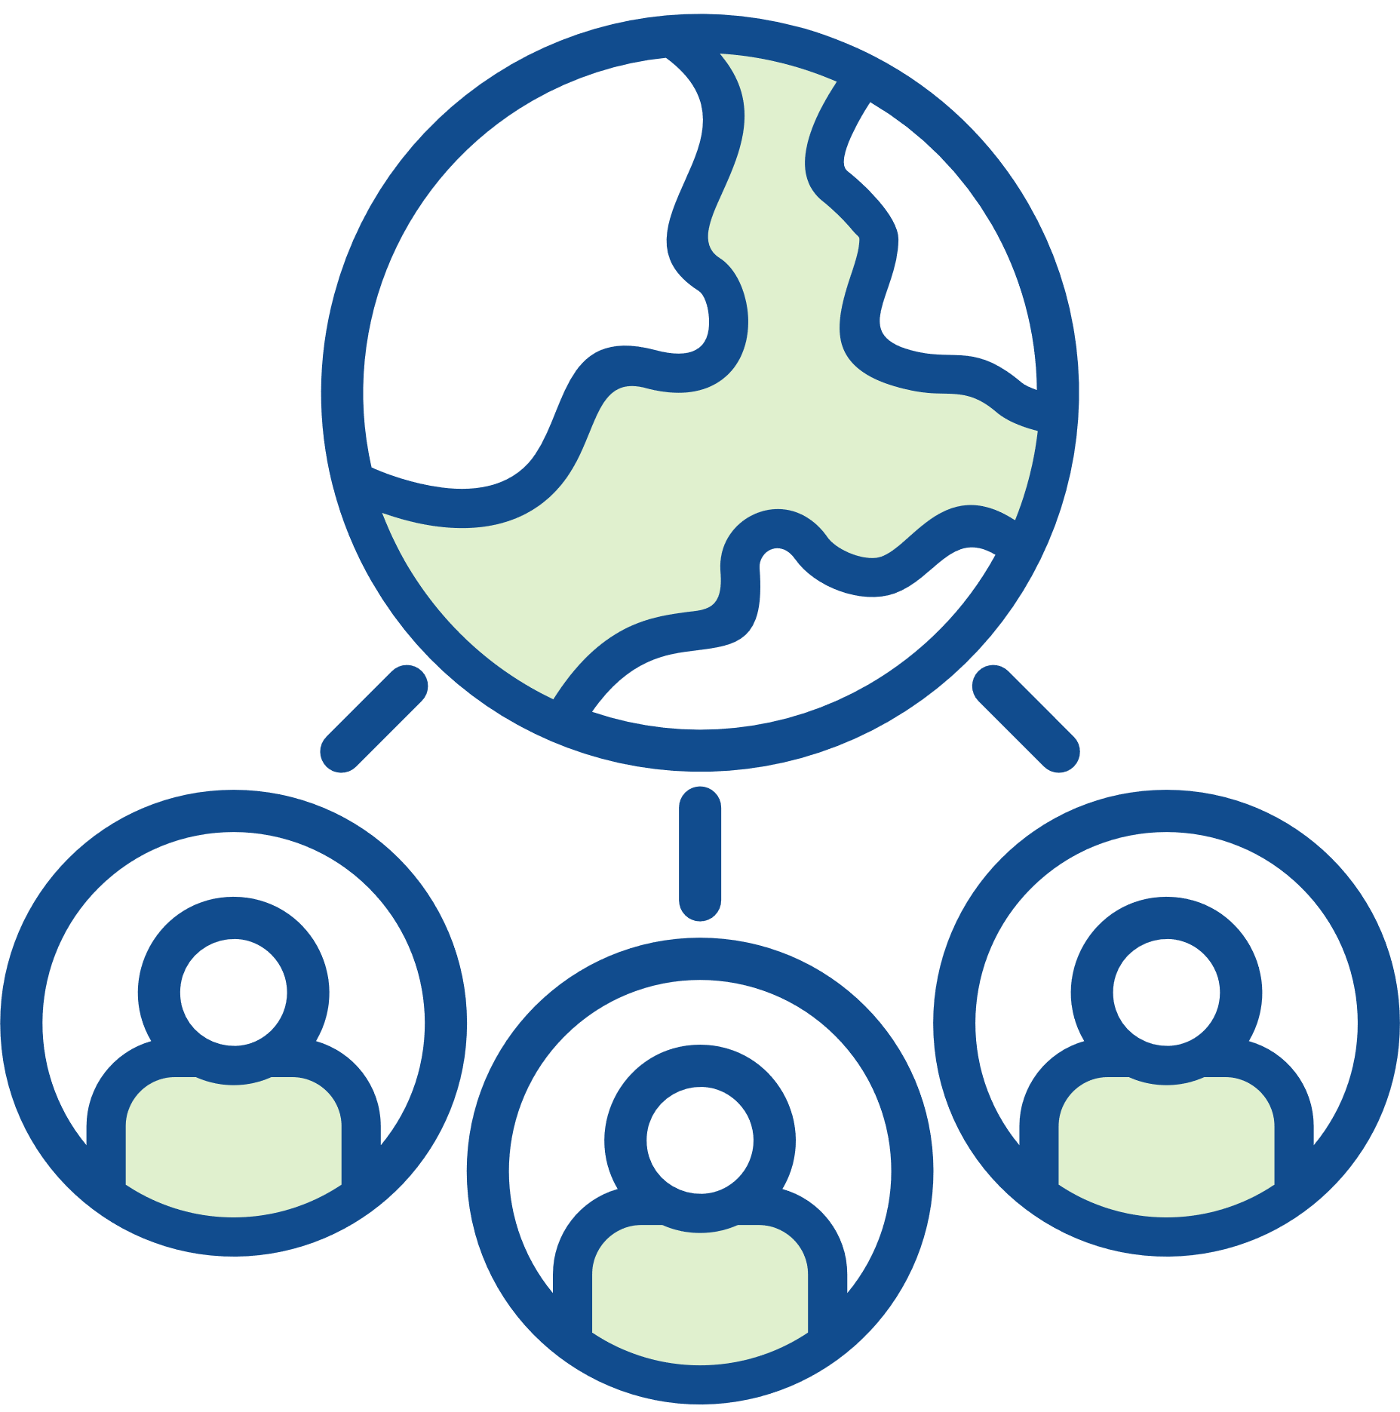
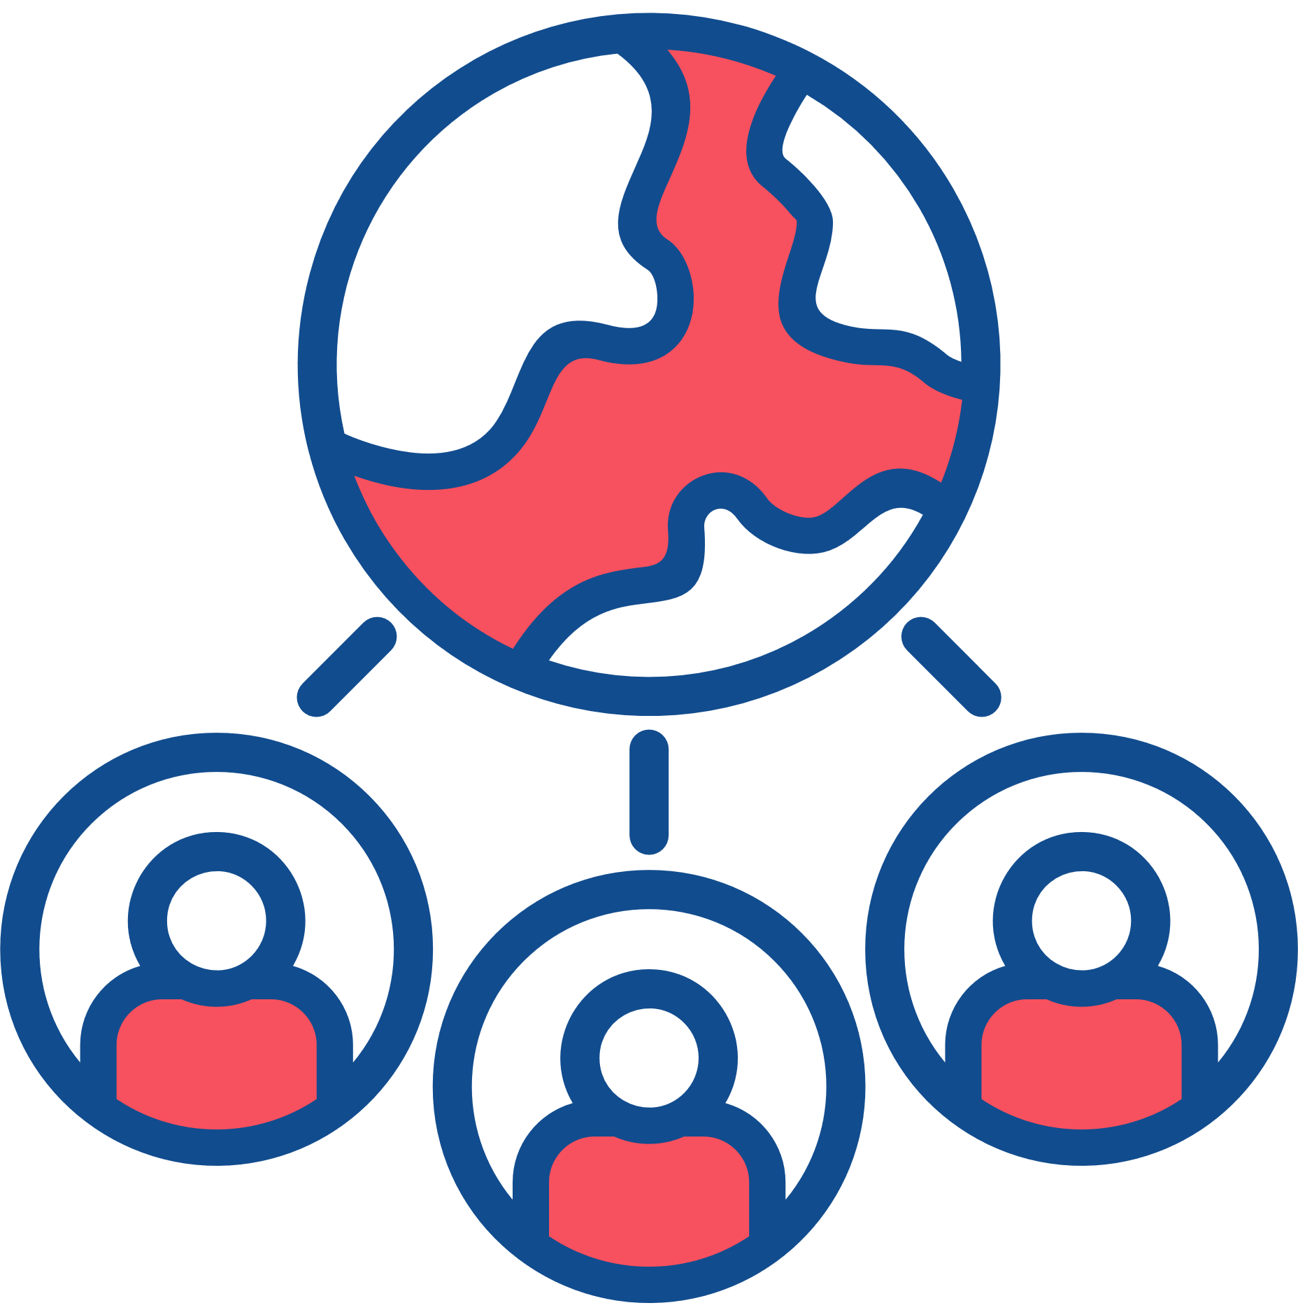
Environmental Sustainability
Facilitating care delivery in multi-professional health centres will mitigate the environmental impact of the care you provide.
Engage with oral health outreach programmes where only the OHP team travels. An example is Childsmile with reduced travel, carbon emissions, and improved air quality.
Provision of on-site preventive care facilities in nursing and care homes.
Centralized resources, procurement, waste management, and circularity.

Slide 28
Procurement

Slide 29
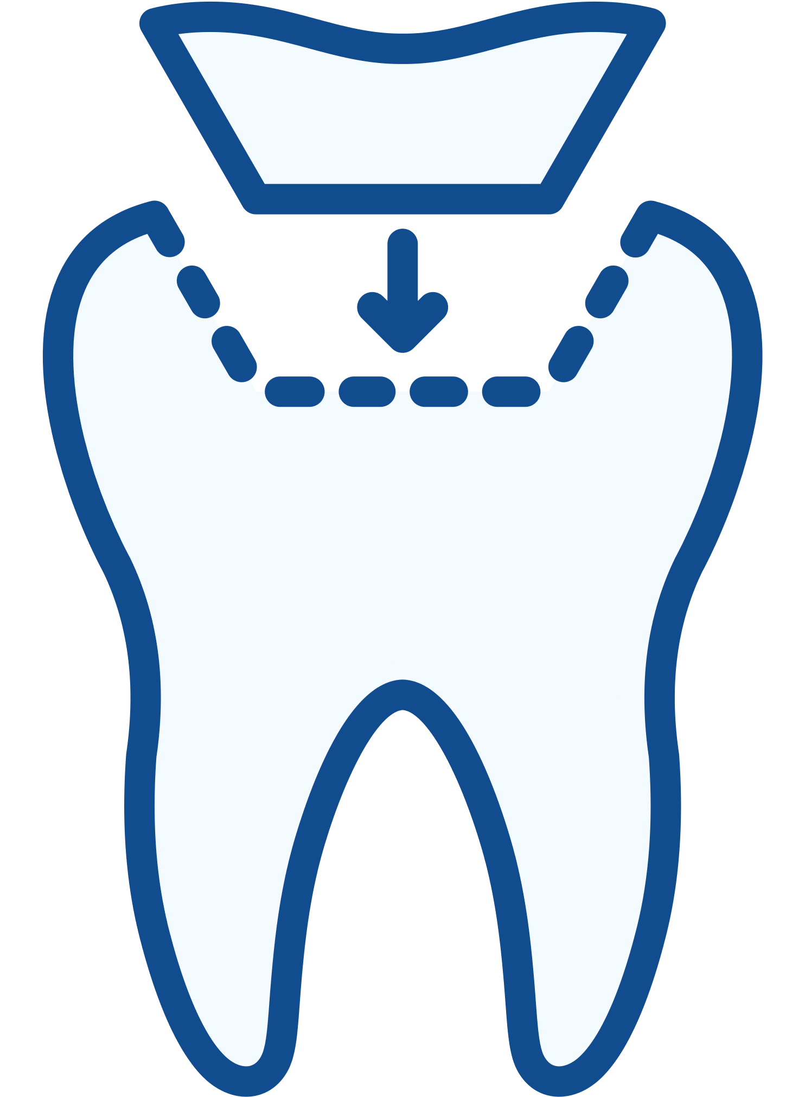
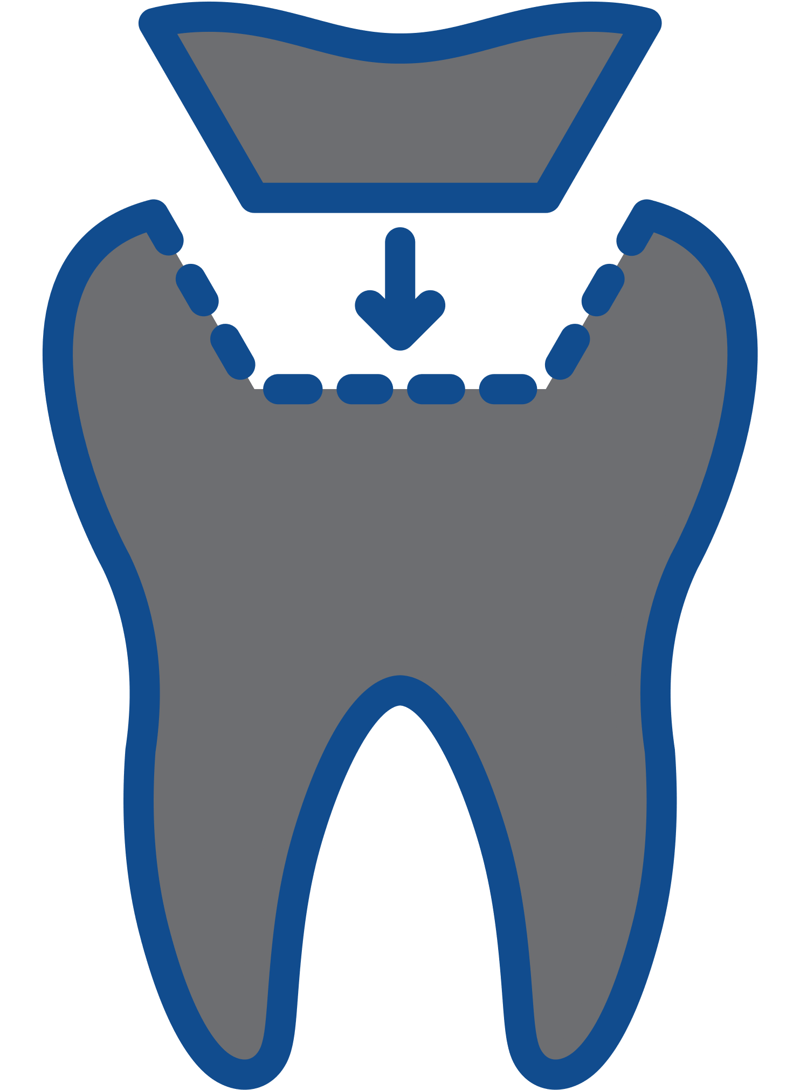



Environmental Sustainability
Selecting fit-for-purpose dental materials, clinical items (PPE and products) and equipment will mitigate the environmental impacts of the care you provide.
Adopt a prevention-first approach to reduce oral healthcare interventions, material use, and
associated environmental impact.
Proactively reduce the use of amalgam in line with the Minamata Convention to phase down and phase out the use of amalgam in clinical dental practice.
Use high-quality materials and follow clinical guides to optimize restoration longevity.
Critically evaluate the environmental impact of all dental materials and incorporate this into decision-making at all levels.
Follow the Directions for Use (DFUs) carefully for each material system for correct and optimum clinical outcomes.
Limit the use of dental amalgam to reduce waste produced.

Slide 30
Energy and
Water Consumption

Slide 31



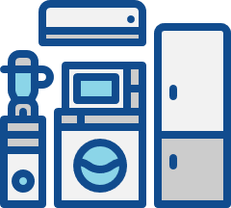


Environmental Sustainability
Reducing energy and water consumption at all levels of oral healthcare is key to mitigating the environmental impacts of oral healthcare.
Use energy-efficient appliances (e.g., LED, fluorescent bulbs, light sensors, dimmer switches).
Make use of natural lighting and turn off the lights when not in use.
Turn off the tap when brushing.
Maintain and upgrade boilers and air conditioning units to ensure they are energy efficient.
Better use of windows and blinds to regulate temperature before using air conditioning.
Use appliances when fully loaded.

Slide 32
Waste Management

Slide 33
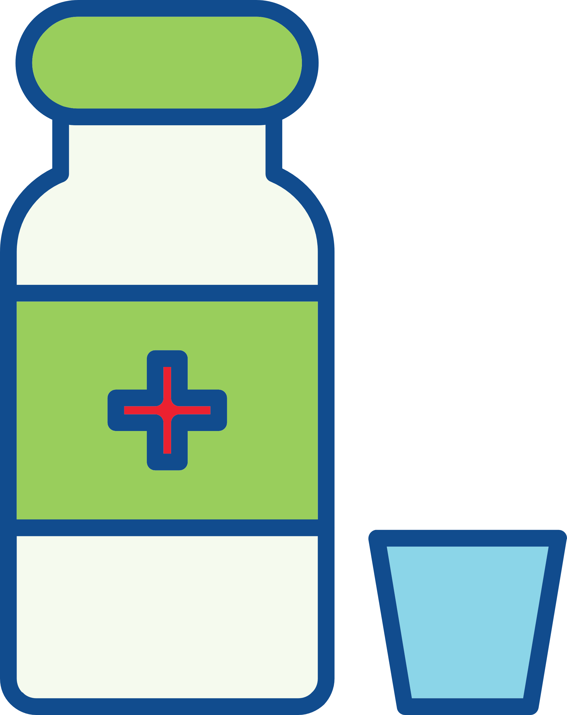
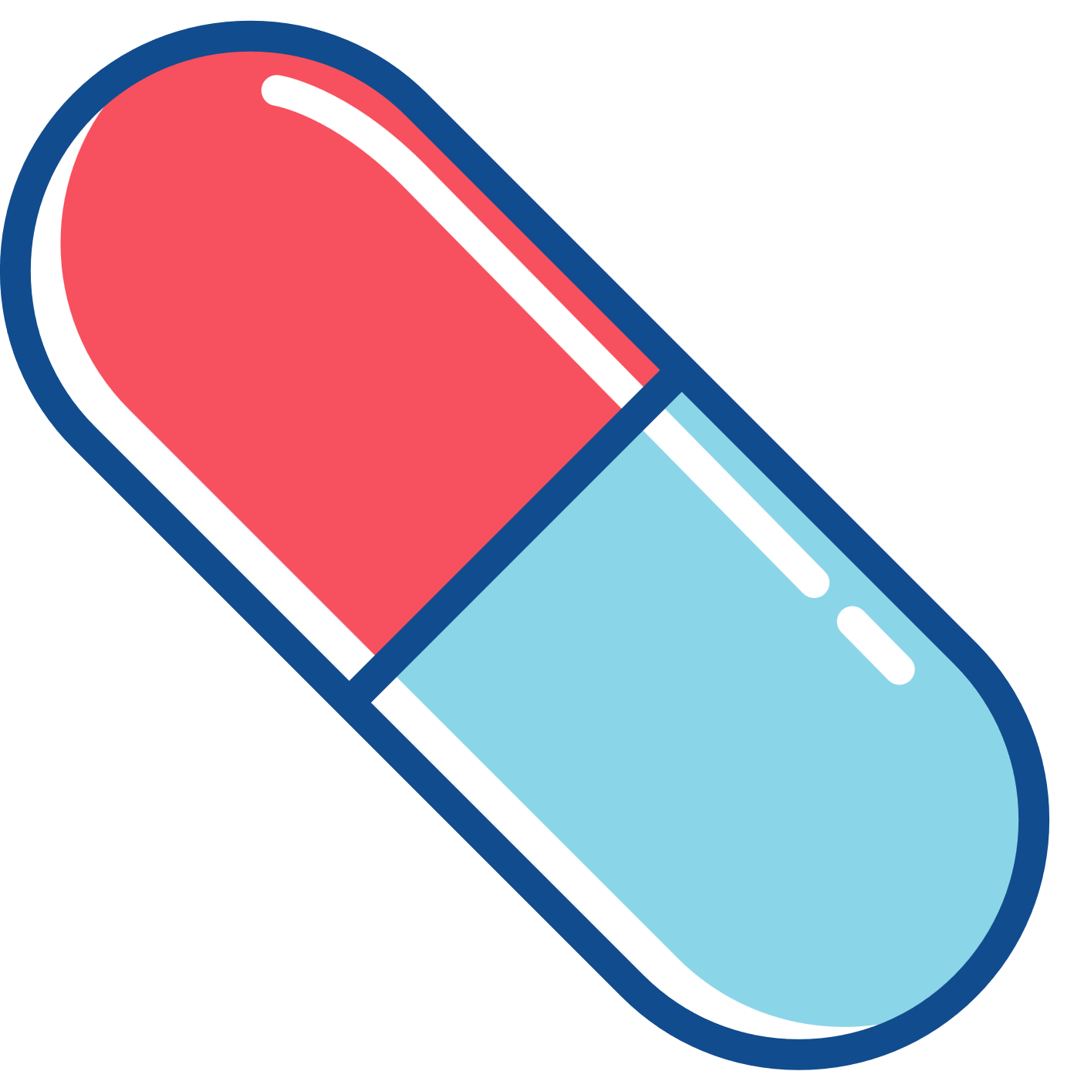
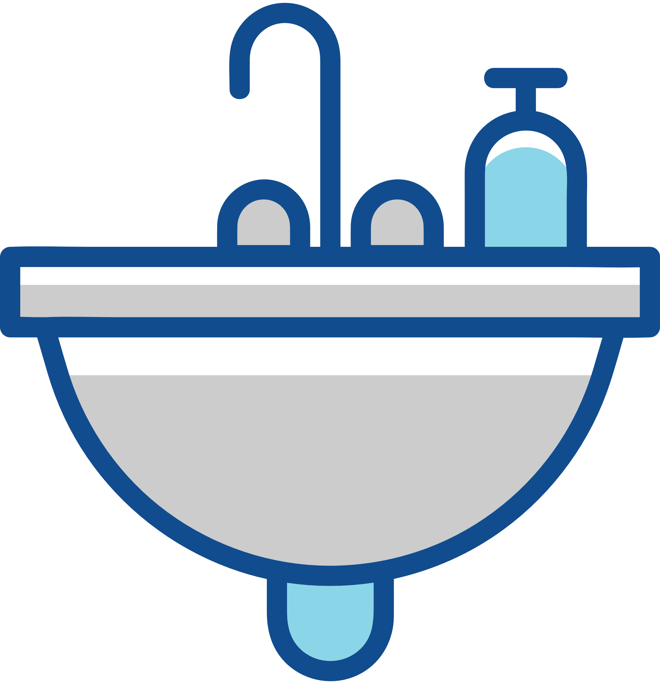
Environmental Sustainability
Reducing medicinal waste through evidence-based prescribing will mitigate the environmental impacts of the care you provide.
Only prescribe the required amount and dose.
Follow evidence-based national/international prescribing guidelines.
Adopt antibiotic stewardship to promote and monitor judicious use of antimicrobials.
Encourage patients to return unused medication to the pharmacy for safe disposal.
Discourage disposal down sink or toilet as this has a huge impact on biodiversity and antibiotic resistance.

Slide 34

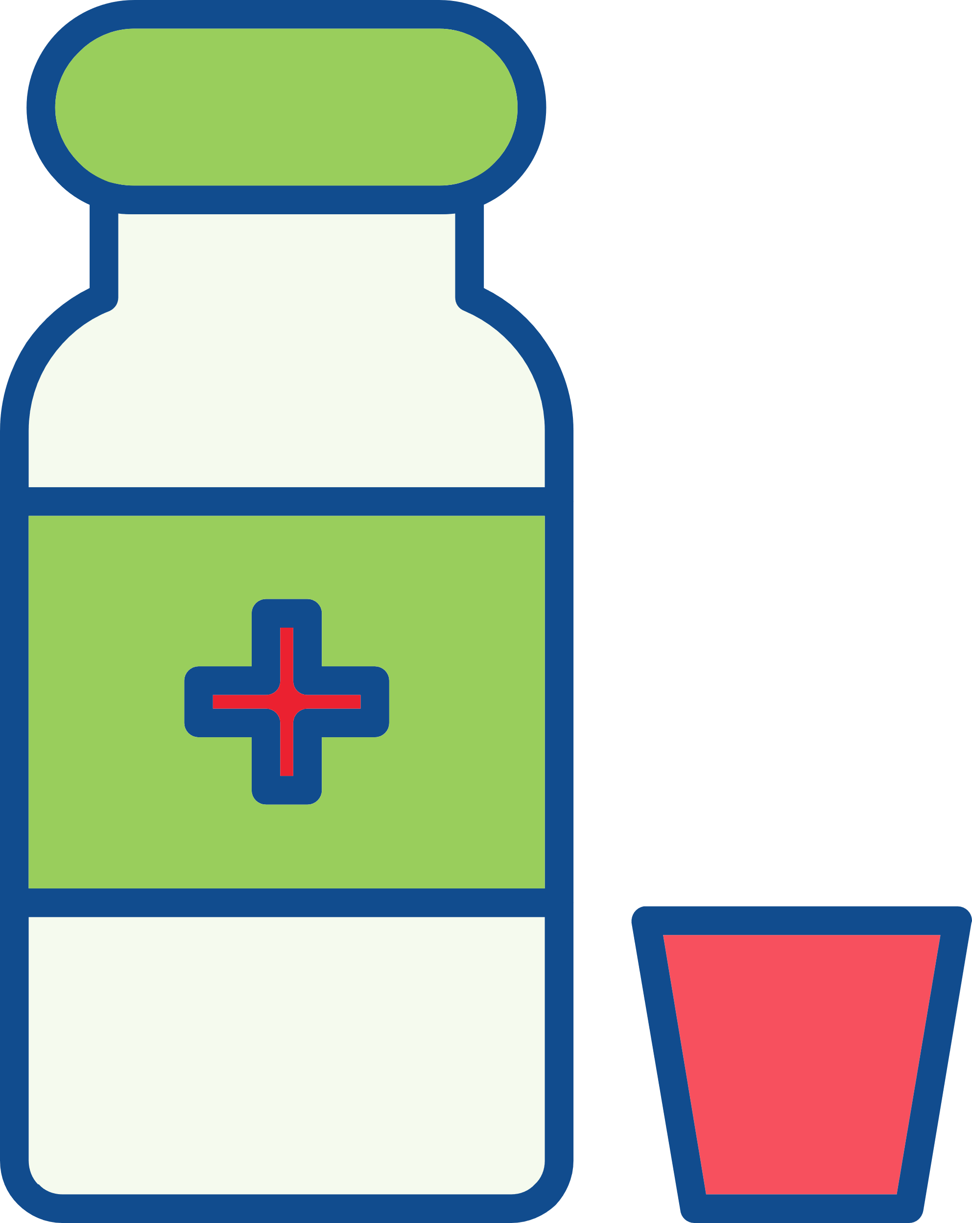
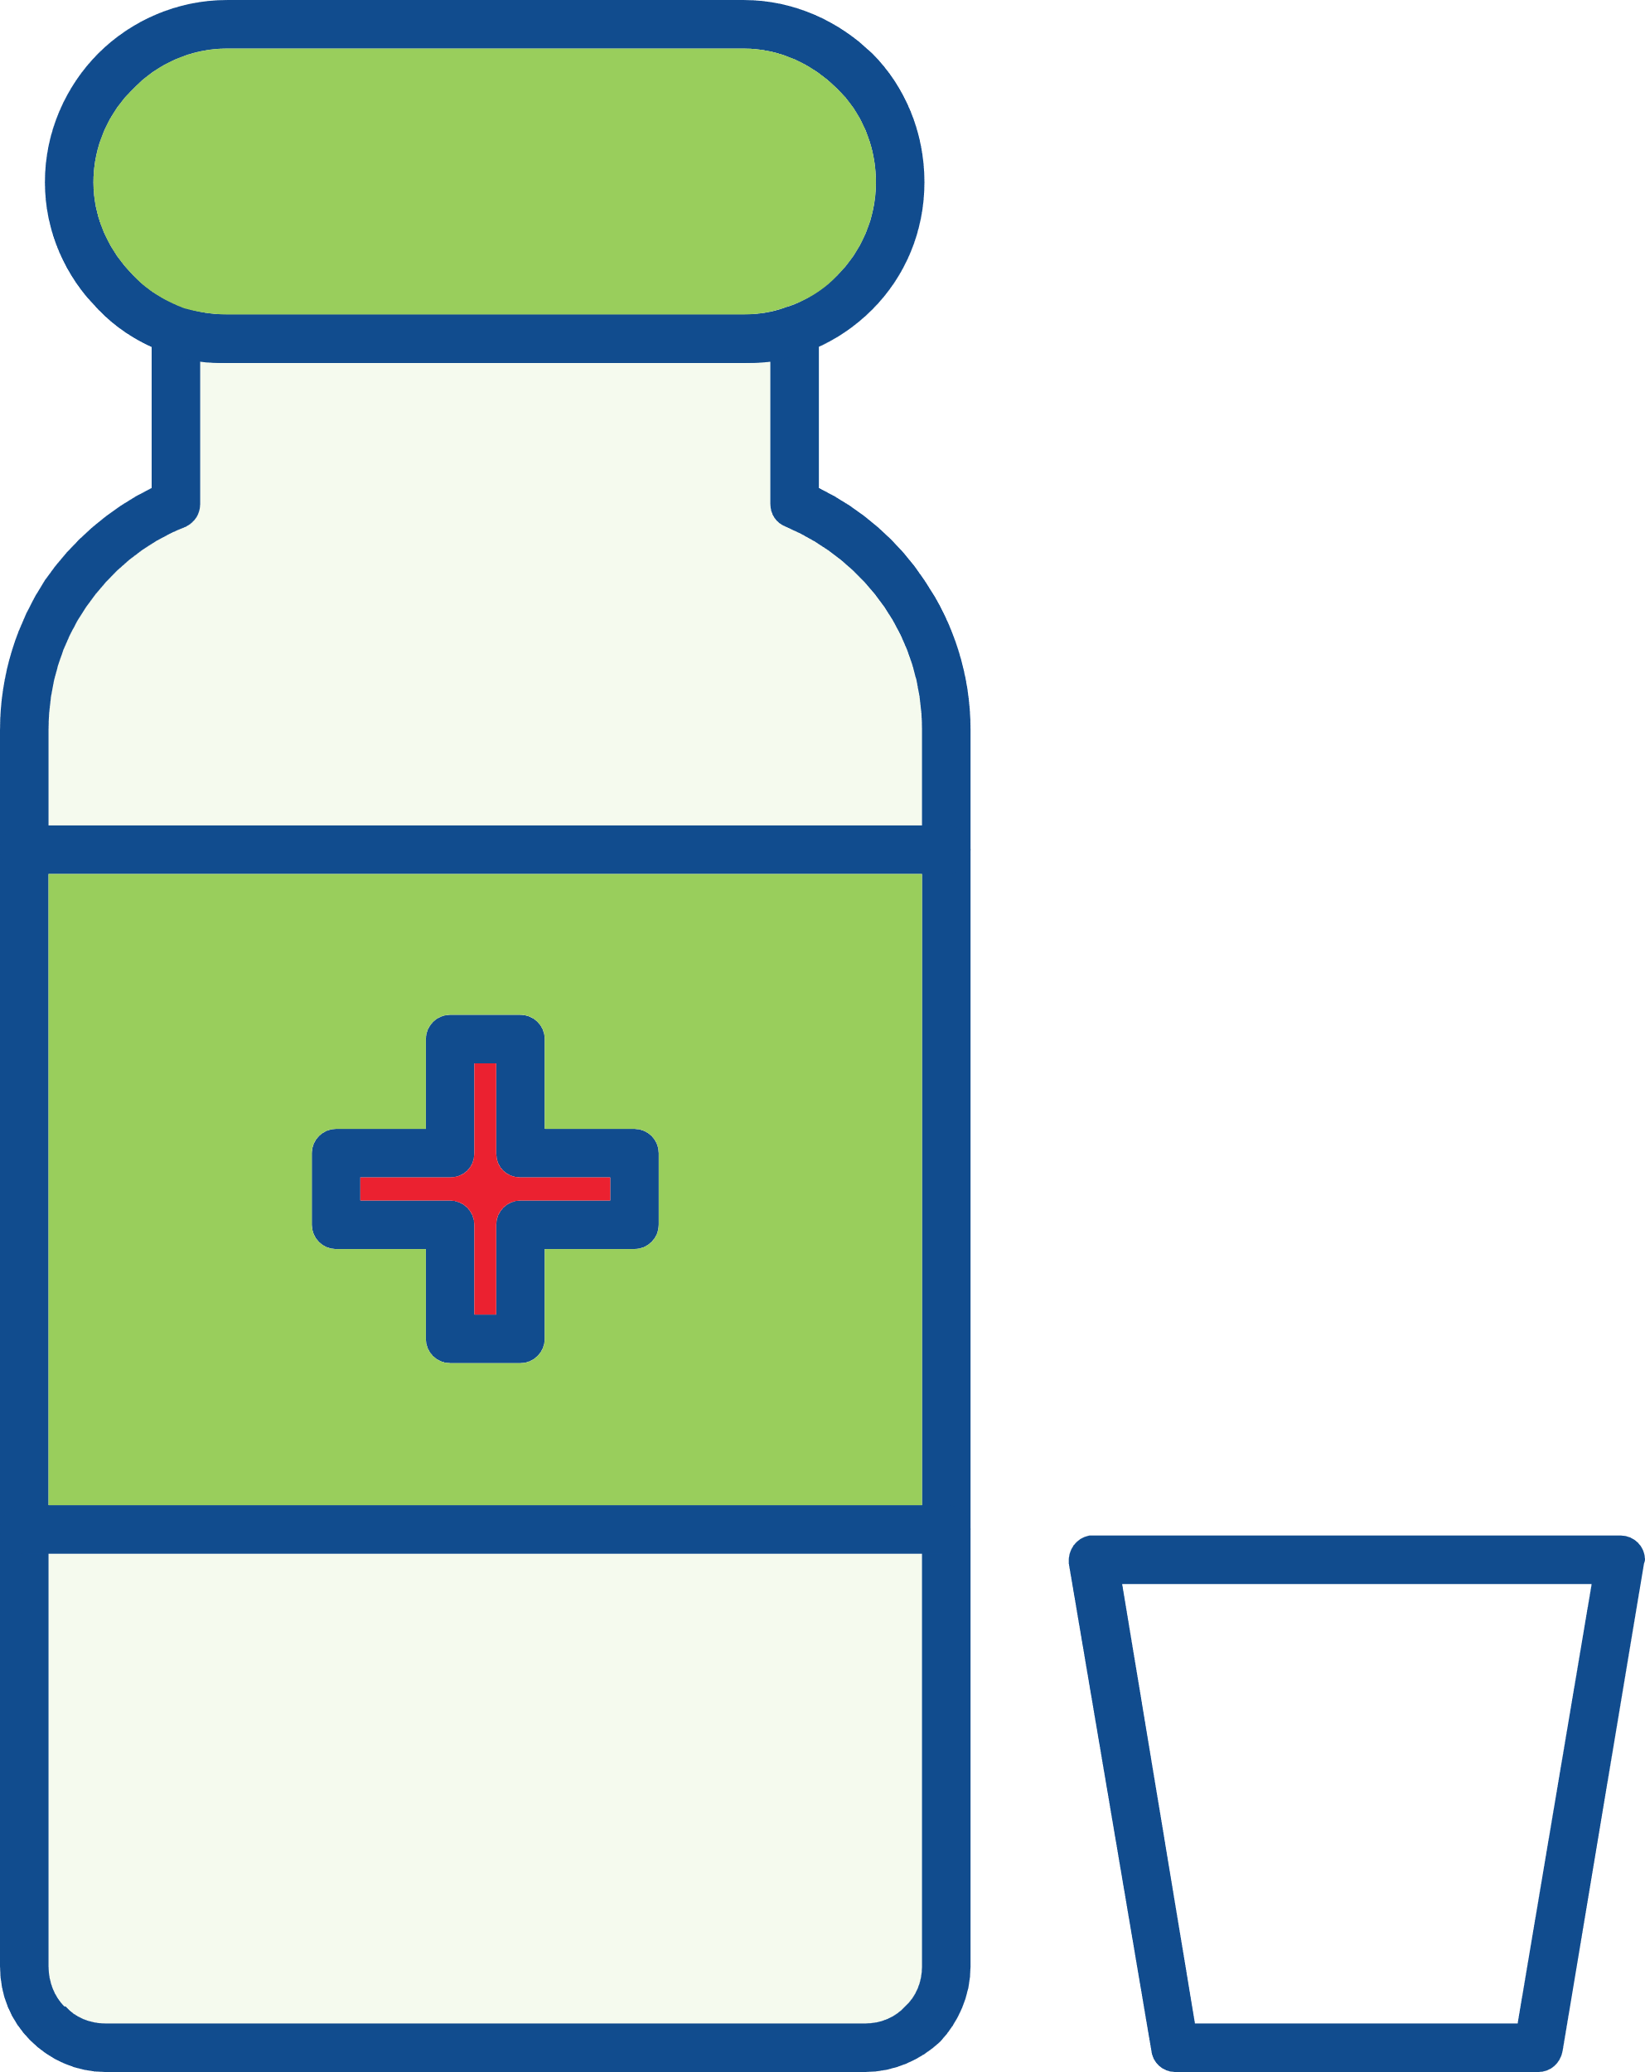
Environmental Sustainability
Reducing and recycling plastic waste will mitigate the environmental impacts of the care you provide.
Minimize single use plastics as much as possible and replace with reusable items including matrix band retainers, anaesthetic syringes, aspiration tips, Dappen’s pots.
Adopt reusables where possible to reduce single use plastic waste.

Slide 35
Dental Material Use

Slide 36



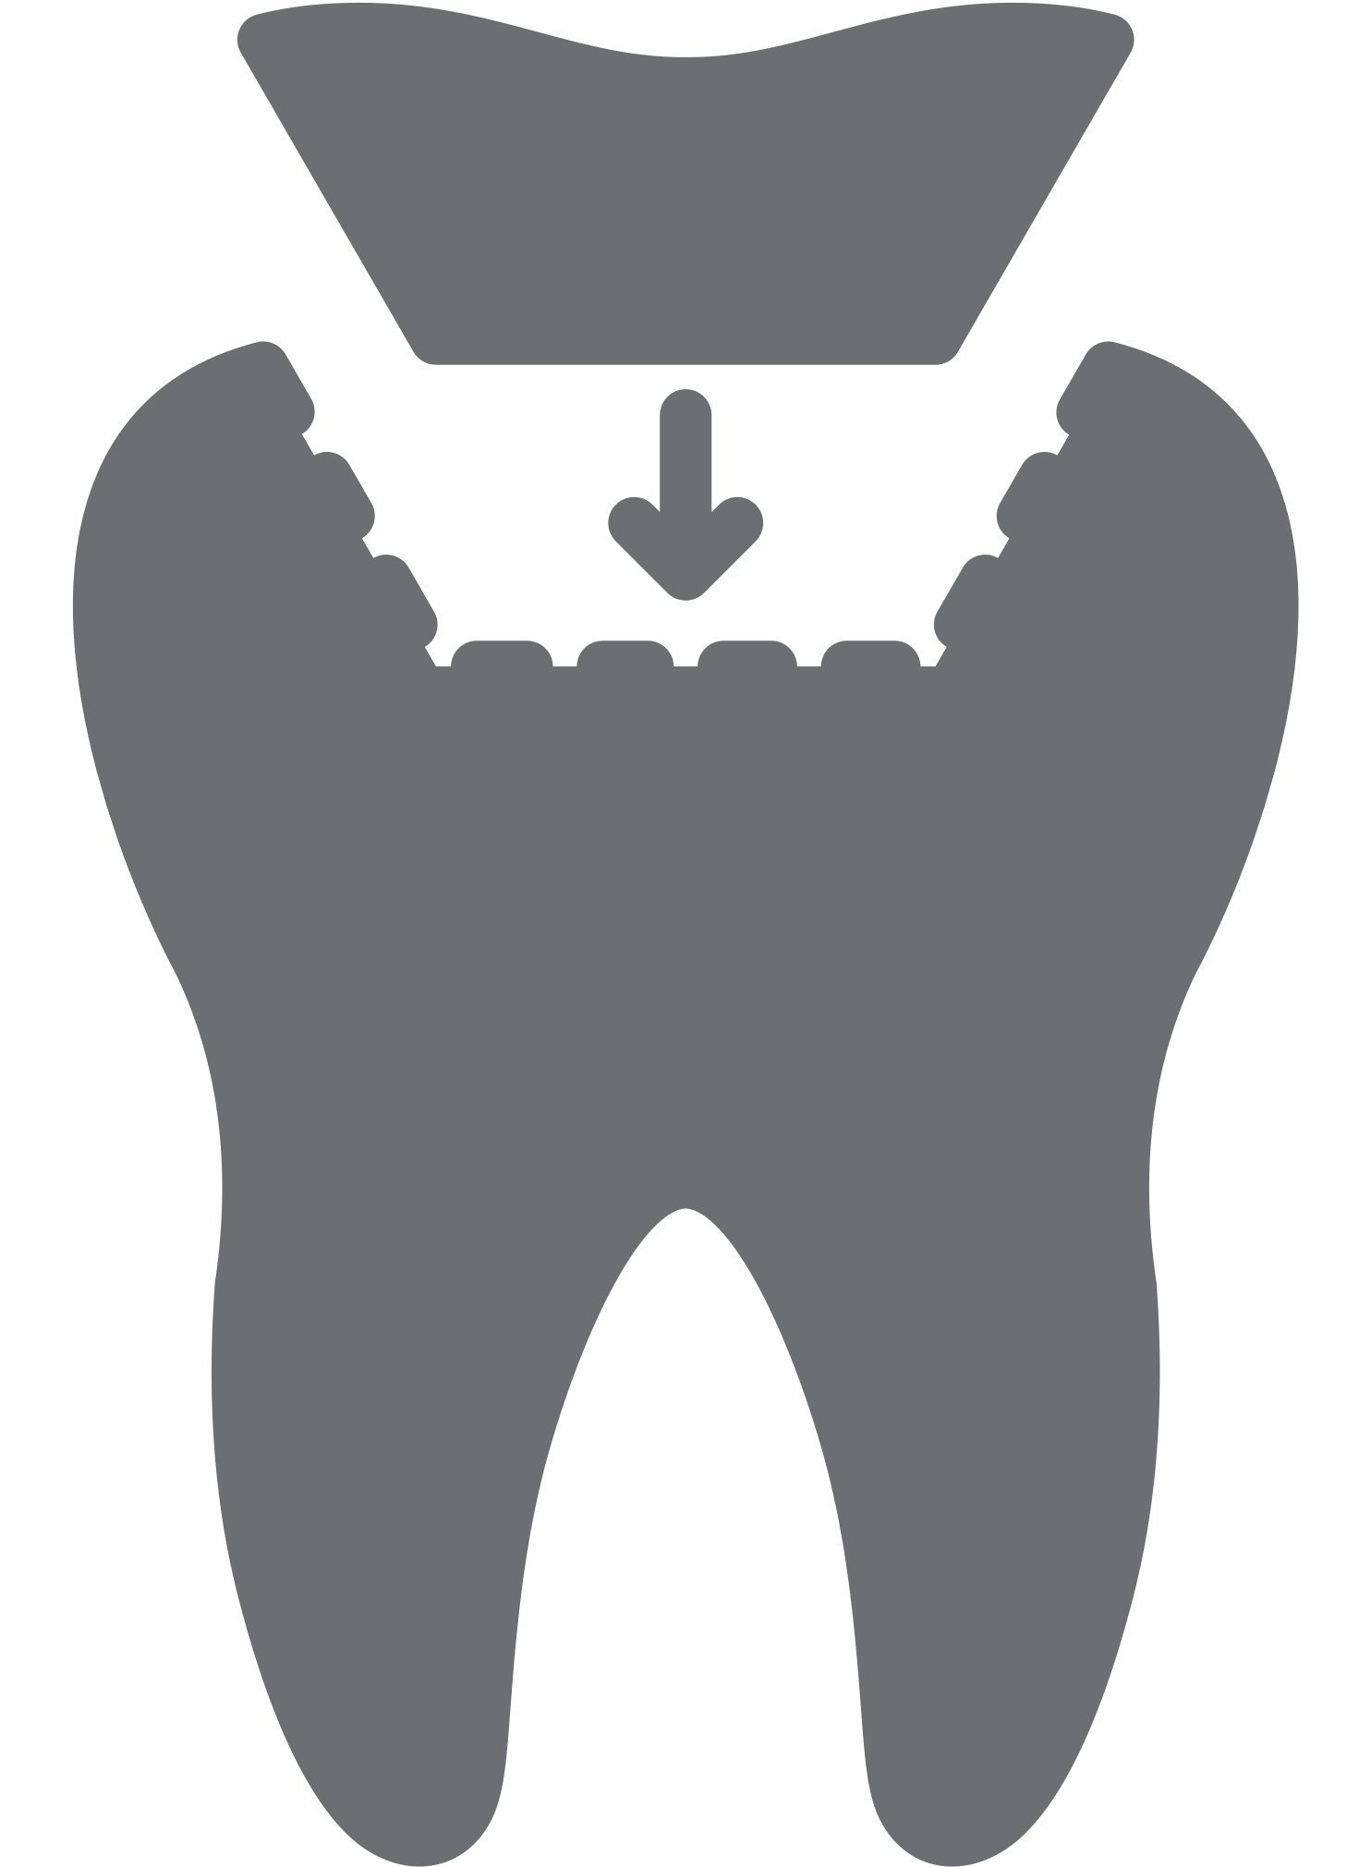
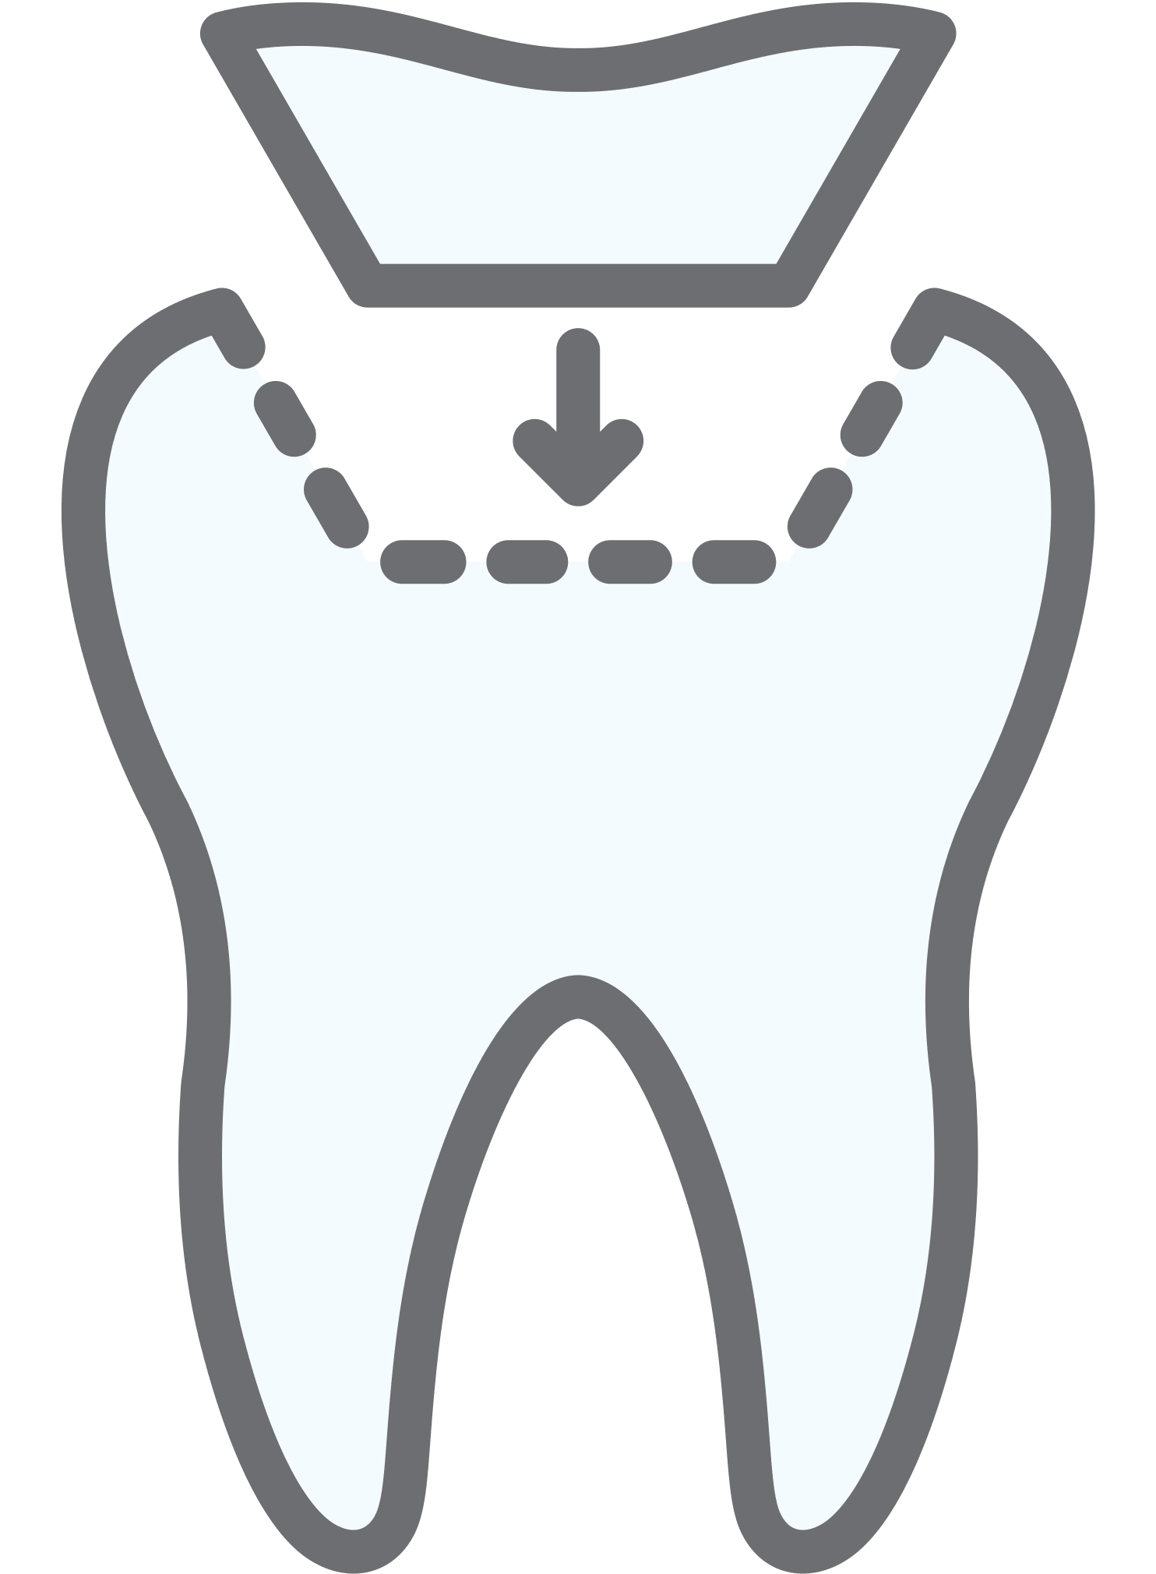

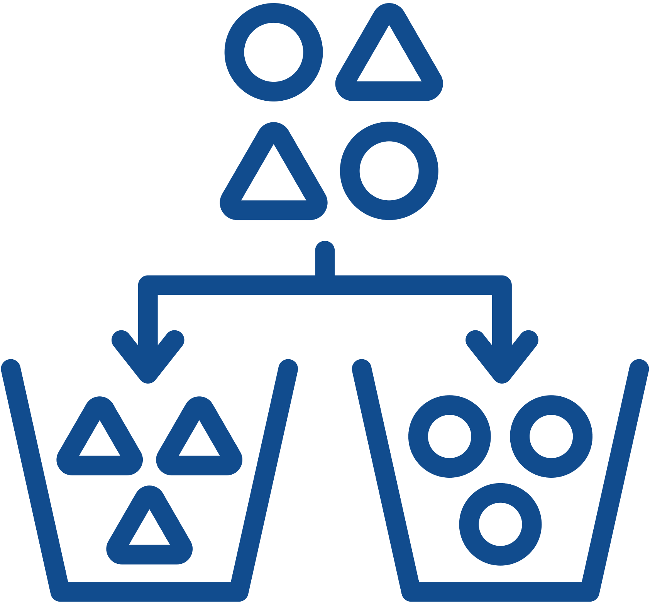
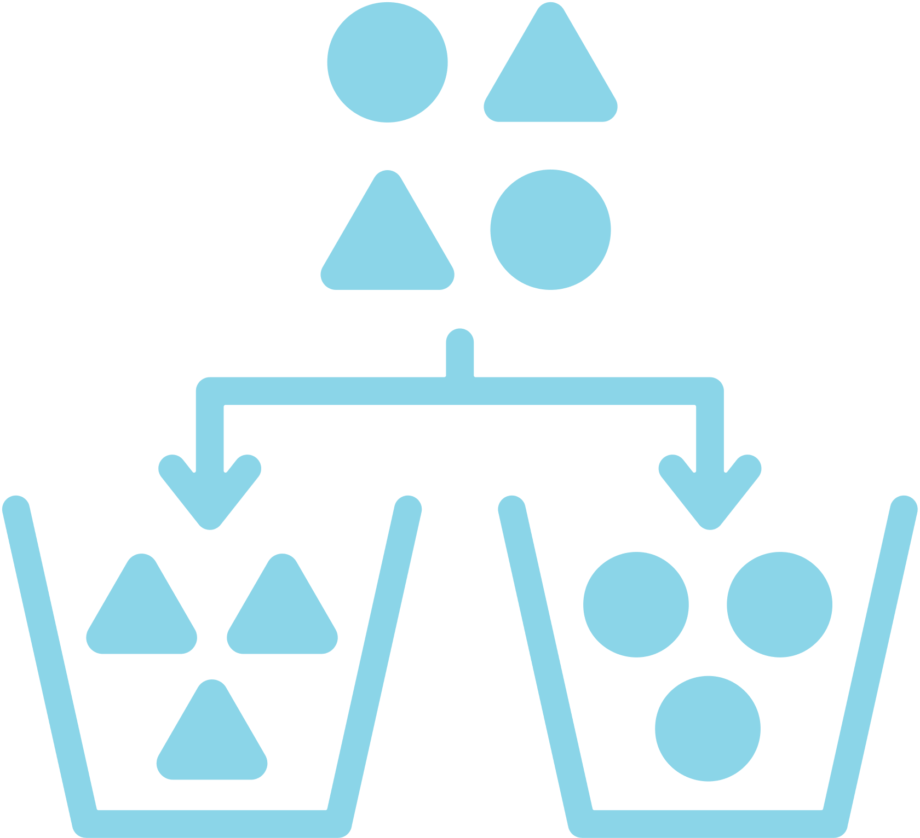
Environmental Sustainability
Managing amalgam waste through safe practices will mitigate the environmental impacts of the care you provide.
Use water-spray and high-volume aspiration when removing amalgam restorations.
Have an amalgam spill-kit for managing elemental mercury.
Avoid the use of hypochlorite cleaners, as they increase dissolution of mercury.
Use effective chairside traps, vacuum filters, and amalgam separators that meet ISO 11143.
Recycle waste amalgam with effective collection, separation, and recovery of mercury and silver through approved biological waste management companies.

Slide 37

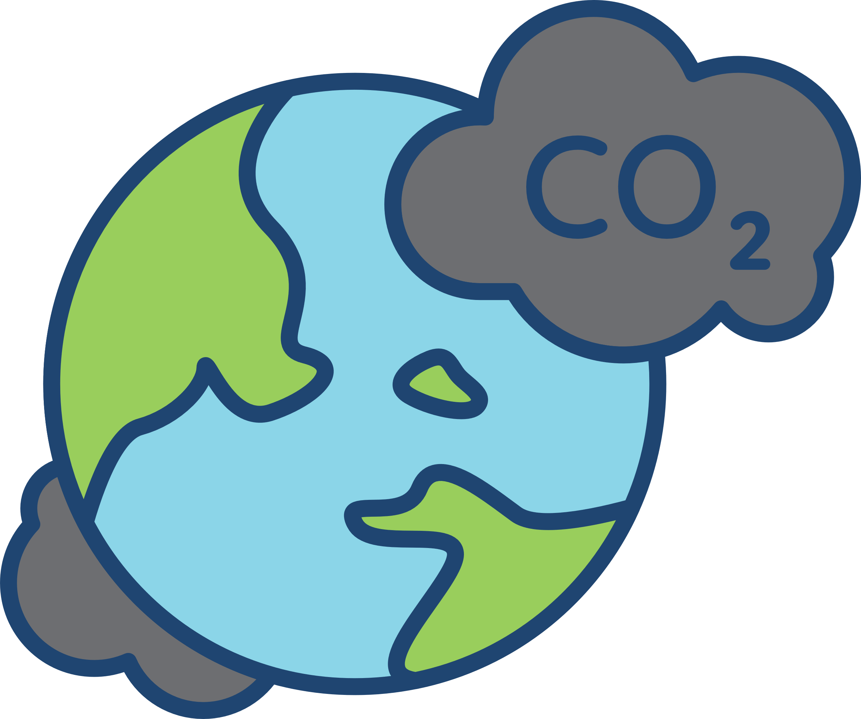
Environmental Sustainability
Reducing the use of nitrous oxide will mitigate the environmental impacts of the care you provide.
Reduce the need for inhalation sedation through high-quality preventive oral healthcare thus avoiding operative interventions and other forms of sedation and anaesthesia.
Capture and neutralize the gas during use.
Use effective protocols and standard operating procedures to avoid atmospheric pollution.

Slide 38





Environmental Sustainability
Reducing gypsum use for dental casts will mitigate the environmental impacts of the care you provide.
Employ intra-oral scanning to reduce impression material and gypsum waste.
Consider 3D printing and biodegradable resins to produce models.
Adopt biodegradable alternatives to gypsum.
Consider recycling options for gypsum.

Slide 39

Environmental Sustainability
Recovering and recycling dental materials, clinical items (PPE and products) and equipment will mitigate the environmental impacts of the care you provide.
Recycle waste amalgam, gypsum, lead foil, and metal used in fixed/removable prosthodontics.
Segregate and recycle sterile packaging.
Use surgery zoning to separate contaminated and non-contaminated waste and facilitate recycling of these items where possible.

Slide 40




Environmental Sustainability
Using digital radiography will mitigate the environmental impacts of the care you provide.
Reduced use of harmful silver thiosulphate fixer.
Reduction of lead foil waste.
Improved image quality, reduced radiation exposure, editing abilities, facilitated storage & access.

Slide 41



Sustainability in Dentistry MOOCs
MOOC 2
Practical Applications of Sustainability in Dentistry
Understand how to implement sustainable practices using the FDI Sustainability Toolkit and other resources and guidance.
MOOC 1
Sustainability in Dentistry
Discover the impact of oral healthcare on the environment and the basic concepts of sustainable practice.

Slide 42
Acknowledgements
Slides
Thank you to Dr. Jonathan Dixon (Clinical Academic Fellow in Restorative Dentistry) for supporting the development of these slides and associated resources, under the supervision of Prof. Nicolas Martin (Clinical Professor in Restorative Dentistry).
Research
Thank you to the authors of the research paper identifying a comprehensive strategy for the inclusion and delivery of Environmental Sustainability in the curriculum.
Dixon, J., Field, J., Gibson, E., and Martin, N. (2024). Curriculum content for Environmental Sustainability in Dentistry. Journal of Dentistry, 147, 105021. doi: https://doi.org/10.1016/j.jdent.2024.105021
Martin, N. and Mulligan, S. (2022). Environmental Sustainability Through Good-Quality Oral Healthcare. International Dental Journal. doi: https://doi.org/10.1016/j.identj.2021.06.005
Task Team
Thank you to the Sustainability in Dentistry Task Team for providing guidance and scientific expertise to ensure sound implementation of the entire Sustainability in Dentistry Project. The team includes:
Chair: Prof. Nicolas Martin (United Kingdom)
Members:
  Dr. Steven Mulligan (United Kingdom)
  Asst. Prof. Duygu Ilhan (Türkiye)
  Asst. Prof. Hasan Jamal (Saudi Arabia)
  Asst. Prof. Donna Hackley (United States of America)
  Dr. Mick Armstrong (United Kingdom)

Slide 43






Partners and Supporters
The Sustainability in Dentistry project is supported by our Partners and Sponsors:
Partners
Supporters

